Slide 1
CalPlanning for FY26 Budget
March 2025

Slide 2
VC Finance Subject Matter Experts
Budget and Financial Operations
Rita d’Escoto
Emily Liu
Herve Bruckert
Rocio Fragoso
Latina Kamau-Kirika
Thomas Choy
Aaron Smyth
Thomas Baza
Financial Systems
Sharon Trahan
Alfred Alipio Jocson
Haidar Alssaqaf
Dara Efron

Slide 3
Agenda
Getting Started
Key dates
Resources for learning and support
Operational updates and best practices
CalPlan
CalPlan Multiyear Budget Template
New Expense Growth Model (EGM) Report
CalPlan data seeded in FY26 Operating Budget
HCP
Composite Benefit Rates and payroll assessments
HCP data seeded in FY26 Operating Budget
HCP Manage Existing and To Be Hired Employees
Review HCM Data to Add to Plan
Resources and Takeaways
New!

Slide 4
Key Dates
March 7
CalPlan and HCP available with FY26 Operating Budget updated with planning data and FY25 Forecast Working version updated with February actual data
March 24
Form A due (for divisions with ladder-rank faculty)
May 26
All budget information due in CalPlanning
FY25 Forecast updates
FY26 Operating Budget
FY27-28 in Multiyear Budget Template
Use of Reserves in Multiyear Budget Template
May 19 – Jun 11
Budget meetings
https://cfo.berkeley.edu/budget-process/fy2025-26-budget-process

Slide 5
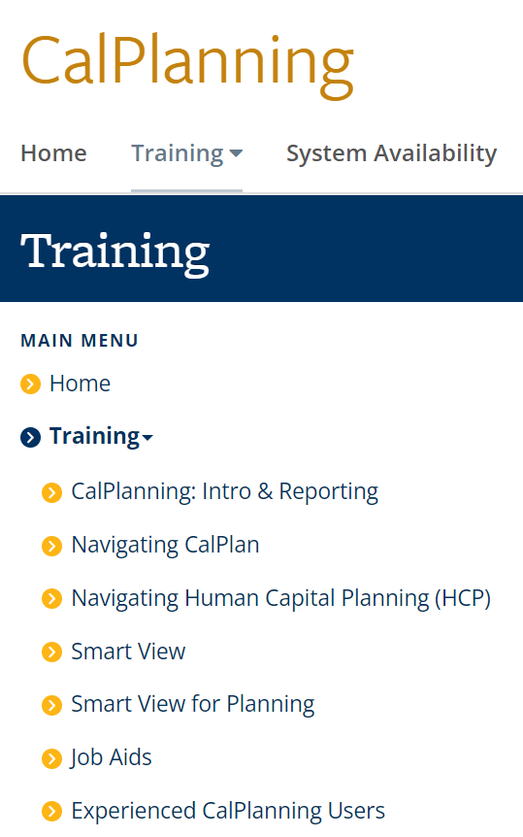
Training
Content for each class is available on the website for anyone to use at any time; no need to enroll in a class
Job aids available on topics across the curriculum
https://calplanning.berkeley.edu/training

Slide 6
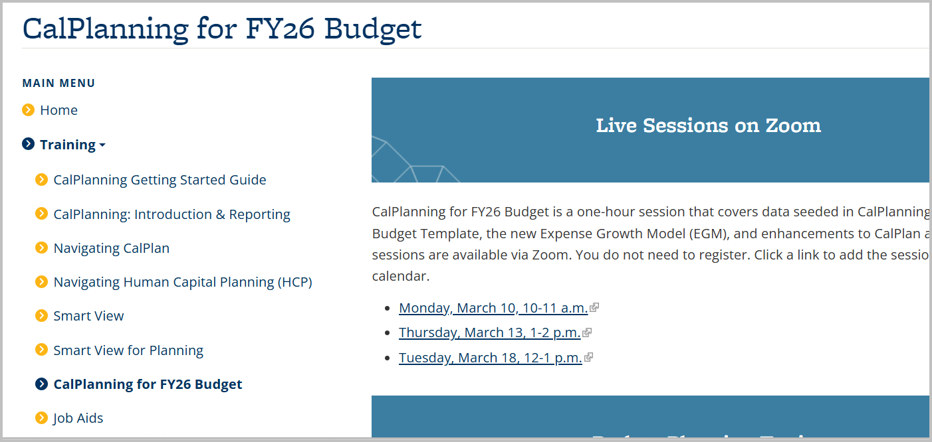
Training
https://calplanning.berkeley.edu/training

Slide 7
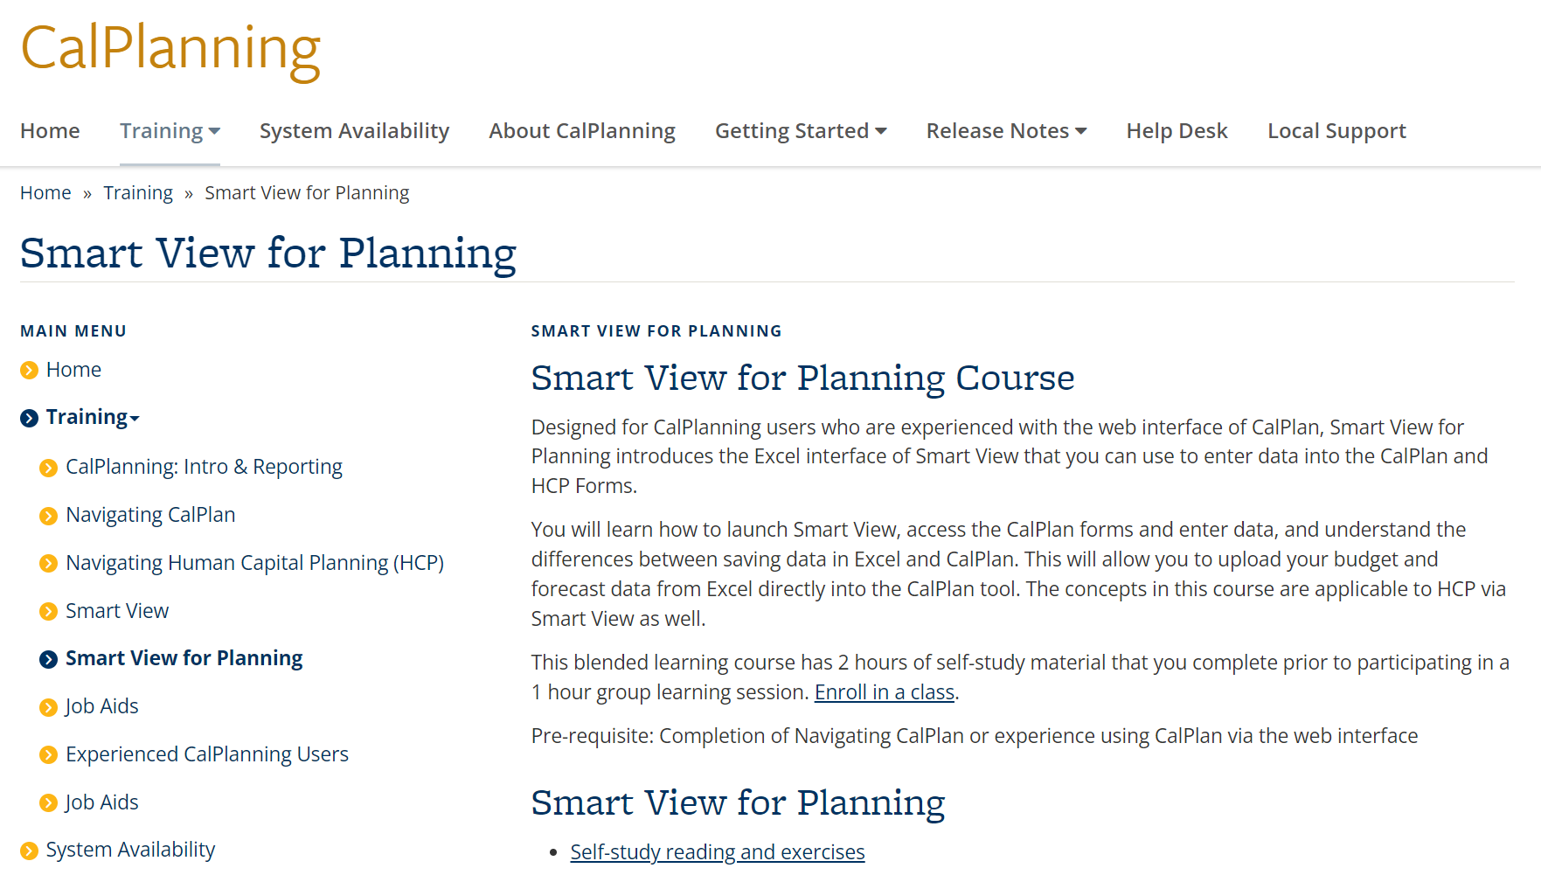
Smart View for Planning

Slide 8
Smart View for Planning
Features and Benefits
Enter plan data into CalPlan and HCP forms in an Excel interface
Data entry, scrolling, searching, and adjusting the view are easier
Share form data with colleagues for review, make updates in Excel, and then load those changes to CalPlanning
Current Smart View for Planning users, be sure to go to Options to:
Check Submit Zero
Do not suppress rows with no data/missing data or Zero
https://calplanning.berkeley.edu/training/smart-view-planning/smart-view-planning-self-study/smart-view-options

Slide 9
Operational Updates and Best Practices

Slide 10
Network, Browser, and Setup Requirements
Network
On Campus: Connect to Eduroam or launch via Citrix
Off Campus: Connect to GlobalProtect or launch via Citrix
Browser
Chrome, Firefox, and Edge are supported
Setup
If you are new to CalPlanning or are now using a computer that has never connected to CalPlanning before, there is some first-time setup required. CalPlanning First Time Setup Job Aid has the details.
https://calplanning.berkeley.edu/training/job-aids/calplanning-first-time-setup

Slide 11
Explore is the door to reports galore

Slide 12
CalPlanning Internal Data Updates

Slide 13
CalPlanning External Data Updates, Actualized Forecast
Actualized Forecast
After BFS closes the general ledger for the month, CalPlanning summarizes the actuals data and loads it to Forecast Working. The actuals data replace what was present and the month is no longer editable.
FY2024-25 Forecast Working version will be updated with February actual data on Tuesday morning March 18 between 6 am and 9 am.
https://calplanning.berkeley.edu

Slide 14
CalPlan: Multiyear Budget Template
Multiyear Budget in CalPlan
Reports
R180 Budget
R181 Use of Reserves
Expense Growth Model
New!

Slide 15
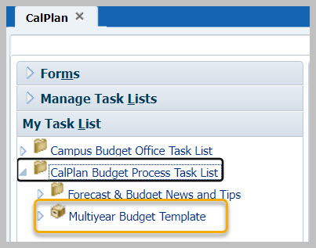
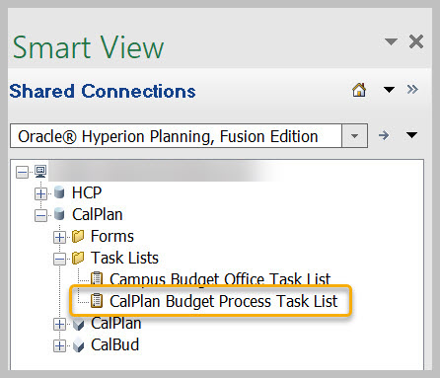
Multiyear Budget Template
The Multiyear Budget Template is available in:
CalPlan on the web | Smart View for Planning - CalPlan
https://calplanning.berkeley.edu/training/job-aids/multi-year-budget-template-job-aid

Slide 16
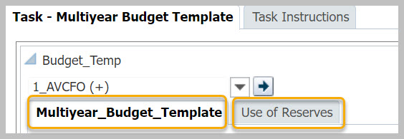
Multiyear Budget Template
The Multiyear Budget Template has two tabs:
Multiyear Budget Template
Use of Reserves

Slide 17
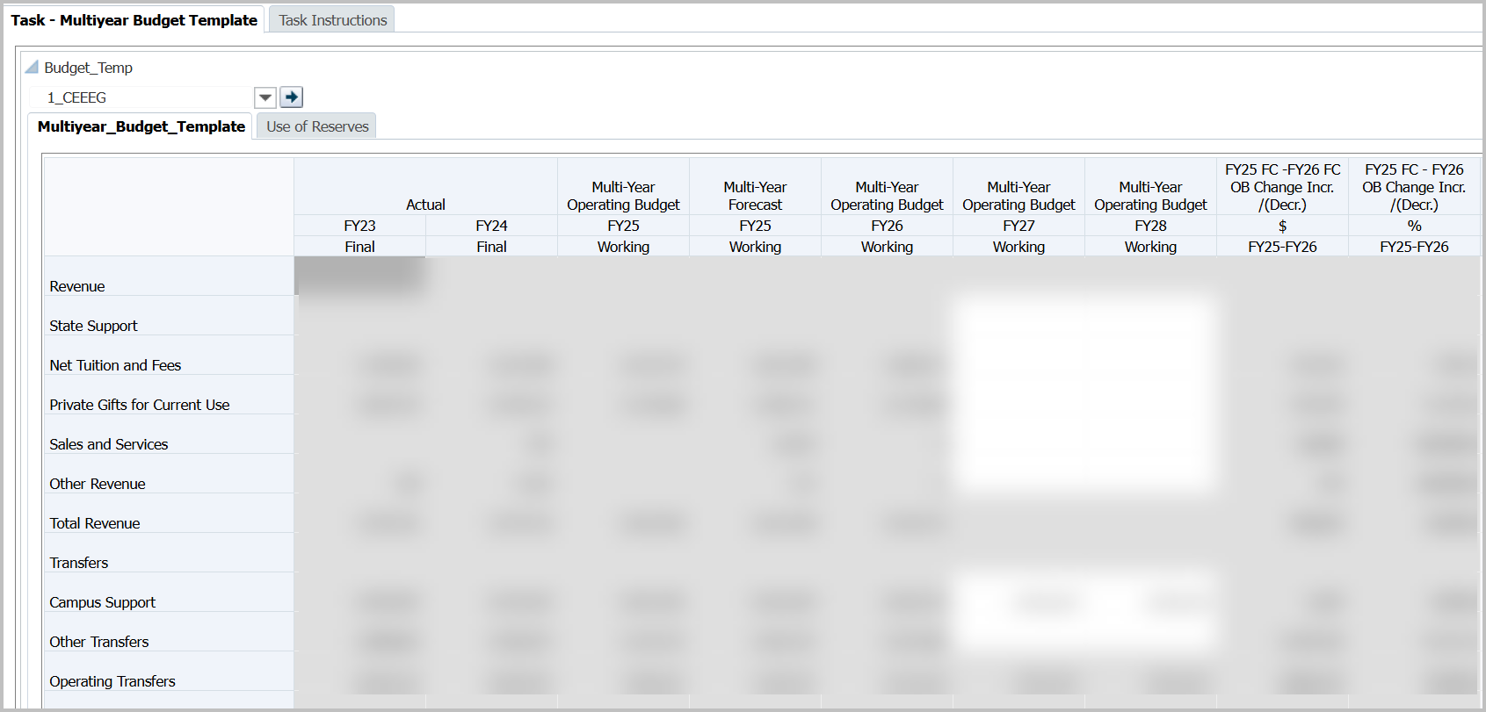
Multiyear Budget Template
Data from FY23-26 is loaded from CalPlan forms
Planners enter data for FY27 and FY28 at L4 Department level
If you would like to enter data at the L3 Division level, select an L4 Department and enter all data there

Slide 18
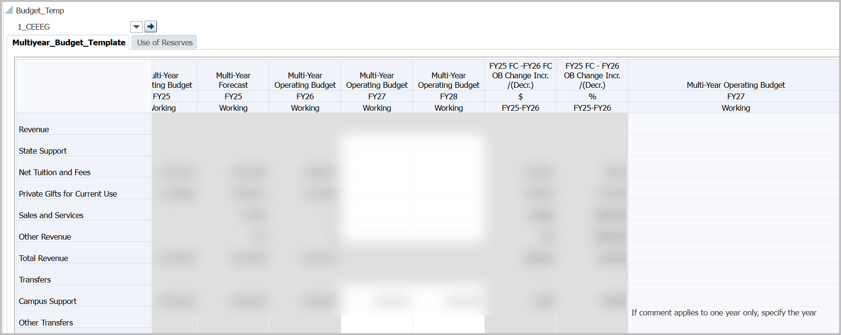
Multiyear Budget Template - Comments
Enter Comments in last column on the right: Multi-Year Operating Budget FY27 Working

Slide 19
Multiyear Budget Template - Save
Select the Save button to save to CalPlanning

Slide 20
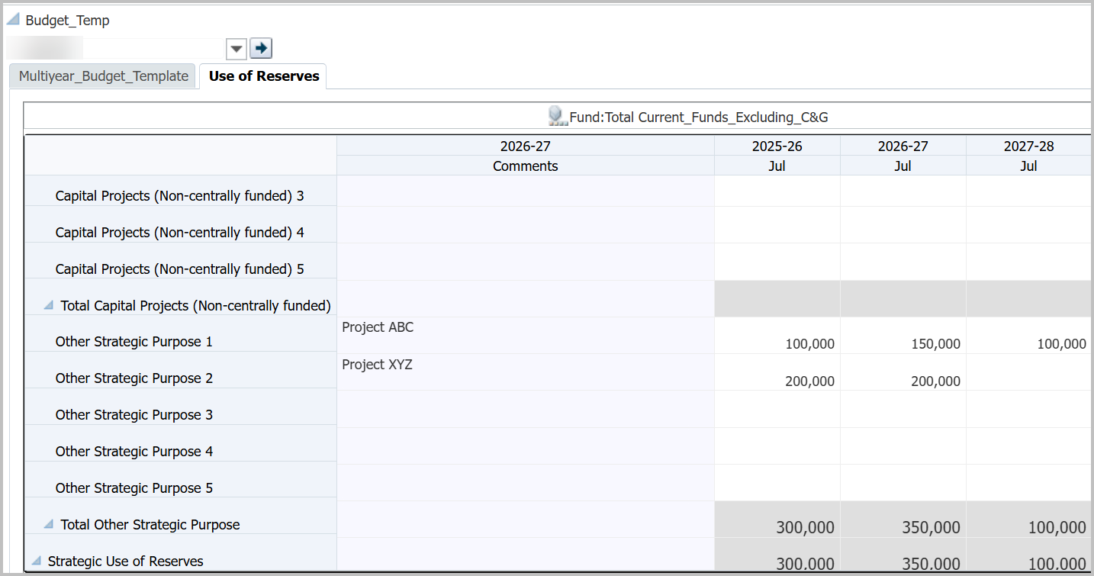
Use of Reserves
The Use of Reserves tab allows planners to show how the organization plans to spend reserves. To keep submissions at a high level, there is a limit of five rows for each category of reserve spending:
Capital Projects
Other Strategic Purpose
Notes:
Changes to the Strategic Use of Reserves Template form and R181 report to limit categories to Capital Projects (Non-centrally funded) and Other Strategic Purpose.

Slide 21
Use of Reserves: Save
Use the Save button to save your numbers and comments to CalPlanning

Slide 22
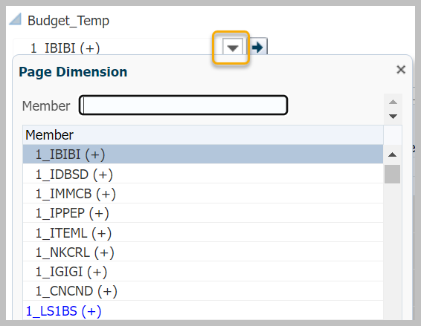
Use of Reserves: Review at Summary Level
To view data at the Division level, open the Entity drop-down and select Division.
Then click the Go button to refresh the data.

Slide 23
Budget Templates
Budget Template is the folder with the templates needed to generate the budget reports. There is a folder for each year. Use the Current Budget Cycle folder.

Slide 24
R180 Budget Template
The CalPlan R180 Budget Template allows you to generate a report showing data for multiple entities so you can see department and division entries, each on their own page.

Slide 25
R180 Budget Template - Respond to Prompts
Respond to Prompts is where you select the entities to include in the report; they can be L4 Departments or L3 Divisions.
If you know the member names, check Edit Member Names and type the entities in the Selection box.
If you prefer to select members from the tree, click the Member Selection button.
Notes:
Changes to Budget Template form and R180 report to include an additional year of Actuals and Operating Budget for comparison purposes

Slide 26
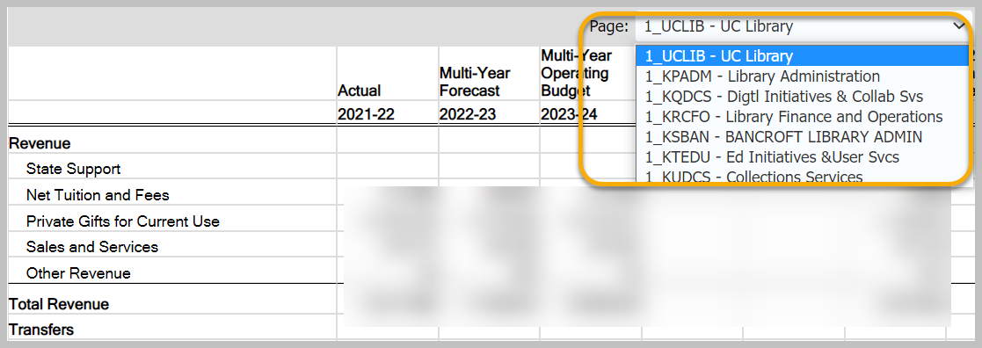
R180 Budget Template Report
Each entity is on a separate page. Use the Page drop-down to select the entity you want to display.

Slide 27
R181 Use of Reserves Template
The CalPlan R181 Use of Reserves presents the data from the Use of Reserves form
Notes:
Changes to the Strategic Use of Reserves Template form and R181 report to limit categories to Capital Projects (Non-centrally funded) and Other Strategic Purpose.

Slide 28
Expense Growth Model Report
One component of the budget deficit mitigation strategy is to slow growth in divisional expenses.
The Expense Growth Model (EGM) calculates an expense growth cap for each division based on different targeted spending levels for different types of expenses from the FY25 Final Operating Budget. For details, see:
FY25-26 Budget Process: Discussion of Divisional Expense Growth Methodology
Presented to Campus Leadership Groups, January 2025

Slide 29
Expense Growth Model Report
Expense Growth Model Target % and $ are based on FY25 Final Operating Budget.
Total Expense Growth Model (EGM) Cap is FY25 Total Expenses + EGM Target $
(Over)/Under Total Expense Growth Model (EGM) Cap is the difference between the EGM Cap and the FY26 Operating Budget (Working)

Slide 30
Expense Growth Model Report
When you generate the Expense Growth Model report, it prompts you to enter one or more entities. Select Edit Member Names to type your division into the text box.
If you open the Member Selection box and don’t see your division, select the Next Page button to move to the next 20 rows.

Slide 31
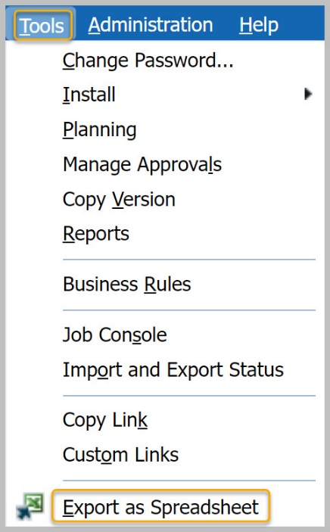
Back up your reports
After the submission deadline of May 2, CalPlanning users will no longer have access to the Budget Reports: R180, R181, and Expense Growth Model. Please export to Excel to create a backup for your records.

Slide 32
CalPlan
CalPlan data seeded in FY26 Operating Budget
Central transfers and commitments

Slide 33
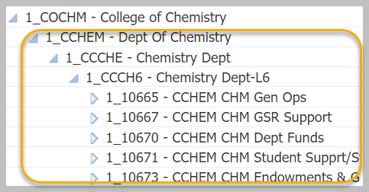
Recommended Org Level Settings
To ensure optimal performance for all users, please use L4, L5, L6, or L7 (Dept ID)

Slide 34
DeptID Inactivation
DeptIDs are set to read-only in CalPlan
DeptIDs are removed from CalPlan when there is no more activity
Actuals remain in the original entity but the Forecast and Operating Budget amounts have been moved to the mapped entity.
For the list of already inactive DeptIDs as well as DeptIDs planned for inactivation, go to the Planning DeptID Inactivation webpage
https://cfo.berkeley.edu/divisional-finance-leaders/dfl-concierge/organizational-tree/request-org-tree-changes/deptid-planned

Slide 35
CalPlan Data Seeded in FY26 Operating Budget

Slide 36
Data Seeded in the FY26 Operating Budget
In October 2024, FY25 Operating Budget Final was copied to FY26 Operating Budget Working. See the release notes for details.
FY26 Operating Budget Working includes all of the updates that planners made through Feb 10, 2025.
Central Transfers & Commitments have been distributed to the units for the FY26 Operating Budget Working.
https://calplanning.berkeley.edu/release-notes/march-2025-release-notes

Slide 37
Central Transfers and Commitments – General Allocation
71110 General Allocation
71290 OP Allocations
75101 Dept – Initial Transfers
FY26 seeded with permanent budget data
to the C1_GENALC general allocation Chart1 member

Slide 38
Central Transfers and Commitments - Campus Support
Campus Support
712xx
713xx
714xx
Updated with most recent commitments data for open periods in FY25 and FY26
Notes
Inclusion in the commitment database does not guarantee future funding. All amounts are subject to change.
Form A Accounts in the 71xxx series have been cleared and will be updated again later this month with Form A data provided by the DFLs for both planning years to the C1_FORMA1 and C1_FORMA2 Form A Chart1 members.
Central transfers were loaded to new CalPlan-only Chart1 members. These are the Chart1 members used only in CalPlanning; they will not be used for the Actuals journals.
Chart1 | Used for
C1_GENALC | General allocations
C1_FORMA1 C1_FORMA2 | Form A data submitted by DFLs

Slide 39
Central Transfers and Commitments - Regents Endowment / FFE
72210 Regents Endowment / FFE
FY26 Operating Budget is FY25 actual payout increased by 3%
44013 – UCBF Endow Income - Restricted
Account 44013 - UCBF Endow Income - Restricted has been added to CalPlan for planning purposes.
The past 12 months of closed Actuals for account 44013 have been copied to the FY2025-26 Operating Budget and increased by 3%.
Information from University Development and Alumni Relations (UDAR) about fund performance is available in the FY2025-26 Budget guidelines and assumptions for potential planner adjustments.

Slide 40
CalPlan Best Practice
Check for intersections (Chartfield1, Fund, Dept ID) have seeded amount copied over from FY25 budget that you need to clear for FY26 budget

Slide 41
Human Capital Planning (HCP)
Set org level
Rates for benefits and fee remission
Data seeded in HCP FY26 Operating Budget
Planning for Existing and To Be Hired Employees
Review HCM data to add to Plan

Slide 42
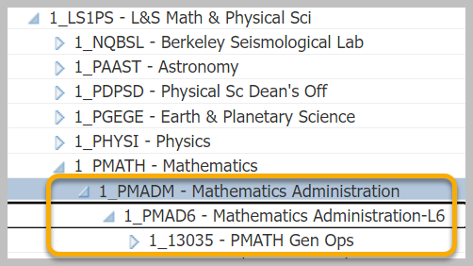
Recommended Org Level Settings
To ensure optimal performance for all users, please use L5, L6, or L7 (Dept ID)

Slide 43
Composite Benefit Rates

Slide 44
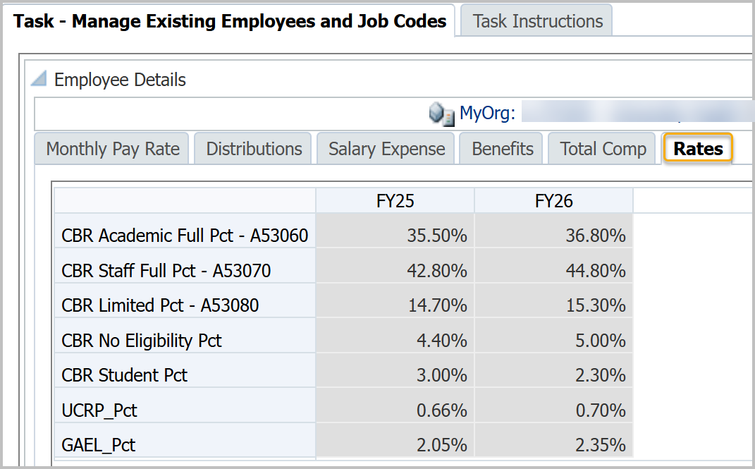
Composite Benefit Rates
Since implementing UCPath, we follow a standard process for calculating rates led by UCOP and will adopt their agreements with the federal government. See Composite Benefit Rate webpage for more information on the calculation.
https://cfo.berkeley.edu/about-us/financial-planning-analysis/budget-and-financial-operations/composite-benefit-rates-cbr

Slide 45
Fee Remission Rates

Slide 46
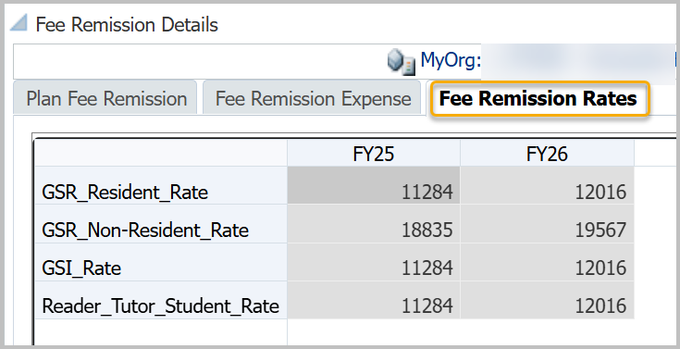
Fee Remission Rates
Fee remission rates were updated with newer rates in January.
https://calplanning.berkeley.edu/training/job-aids/drill-through-account-details-job-aid

Slide 47
HCP Data Seeded in FY26 Operating Budget

Slide 48
HCP FY25 Forecast Copied to FY26 Operating Budget
Monthly Pay Rates
Copied with a 3.7% increase over FY25 Jun pay rate for:
Individually-planned employees
To Be Hired employees
Increase amounts vary by union; see Release Notes for details
Pooled Positions
Increased by 3.7% over FY25
See the job code-to-pooled position mapping file
DeptID Comp Adjustments
Not copied to FY26
https://calplanning.berkeley.edu/release-notes/march-2025-release-notes

Slide 49
Planning for Existing and To Be Hired Employees
Forms and processes to help you plan for existing and to be hired employees:
Create Backups
Compare HCP to your budget
Review HCM Data
Update employees with changes
To Be Hired Employees
Create backups
Save backup copies of Monthly Pay Rate and Distributions tabs on the Manage Existing Employees and Job Codes task.
Compare HCP to your budget
Compare Compensation Drill Through to your offline salary expense by employee. Edit Employee Details in Monthly Pay Rate and Distributions tabs as needed.
Review HCM Data
to Add to Plan one Dept ID at a time. Brings data from UCPath into CalPlanning.
Update employees with changes
Update Manage Existing Employees and Job Codes Monthly Pay Rate and Distributions tabs for employees who will leave or change job code, DeptID, fund type, or Chart1.
To Be Hired Employees
Confirm that To Be Hired employees reflect the open positions in UCPath that the team intends to fill. If you Added HCM Data to Plan for all employees in a DeptID, you will need to re-enter the data for the To Be Hired employees. Refer to the backup copies you made at the start of the process.

Slide 50
Backup HCP Data
Backup from the Manage Existing Employees and Job Codes task:
Monthly Pay Rate
Distributions
From the menu, select Tools / Export as Spreadsheet

Slide 51
Review HCM Data to Add to Plan

Slide 52
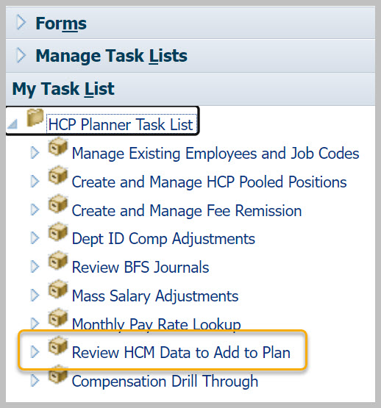
Review HCM Data to Add to Plan
Task and form helps you update your plan with:
Current and future pay rates and distributions for existing employees
New hires and transfers into your department
Employees who have left your department and should be removed from your plan

Slide 53
Review HCM data to add to plan: FY26 Salary Increases
Employee Type | Union Code | FY25 Monthly Pay Rate Increase
Ladder-Rank Faculty | A1 & A2 | 3.7% range adjustment eff Oct 1 (subject to change, contingent on State support)
Non-Represented | 99 & FX | 3.7% increase eff Jul 1 (subject to change, contingent on State support)
CX - Clerical & Allied Services | CX | 3.7% increase plus a step increase effective Jul 1
DX - Student Health Phys & Dentists | DX | 5% increase effective Jul 1
IX - Non-Senate Instructional PA - Police Officers | IX PA | 4% increase effective Jul 1
LX - Professional Librarians RA - Academic Researchers | LX RA | 3.5% increase effective Jul 1
GS - Berkeley Printing Trades KB - Berkeley Skilled Craft | GS KB | 4% increase eff Oct 1
HX - Residual Health Care Prof RX – Research Support Professionals TX – Technical | HX RX TX | 3% increase eff Jul 1; step increase eff Jan 1
SX - Service | SX | step increase effective Jul 1; 3% increase effective Oct 1
NX - Registered Nurses | NX | step increase effective Jul 1; 5% increase effective Jan 1
EX - Patient Care Technical | EX | step increase effective Jul 1; 3% increase effective Apr 1
PX - Post Doctoral Scholars | PX | The new salary scales are on this UCOP website, Table 23.
Notes:
Monthly FY25 pay rates were increased by percentage and timing indicated in the chart.
Salaries for employees paid over 10 months corrected to remove the need for manual salary adjustments. HCP spreads annual salaries over 12 months. Employees with ‘1/10’ in their titles had their annual salary multiplied by 12/10 so that the 12-month spread and annual salary are correctly calculated.
Employees with end dates were extended, except contract appointment employees and employees who separated or were on unpaid leave before 2/1/2024.
BX - Academic Student Employees & BR - Graduate Student Researchers employees are in pooled positions. See the Current Rates (BX) website for salary scale information.
In cases where a union contract is expiring, the salary increase from the prior year is planned forward for budgeting purposes. You may need to update your budget plan as new union contracts are negotiated and ratified.

Slide 54
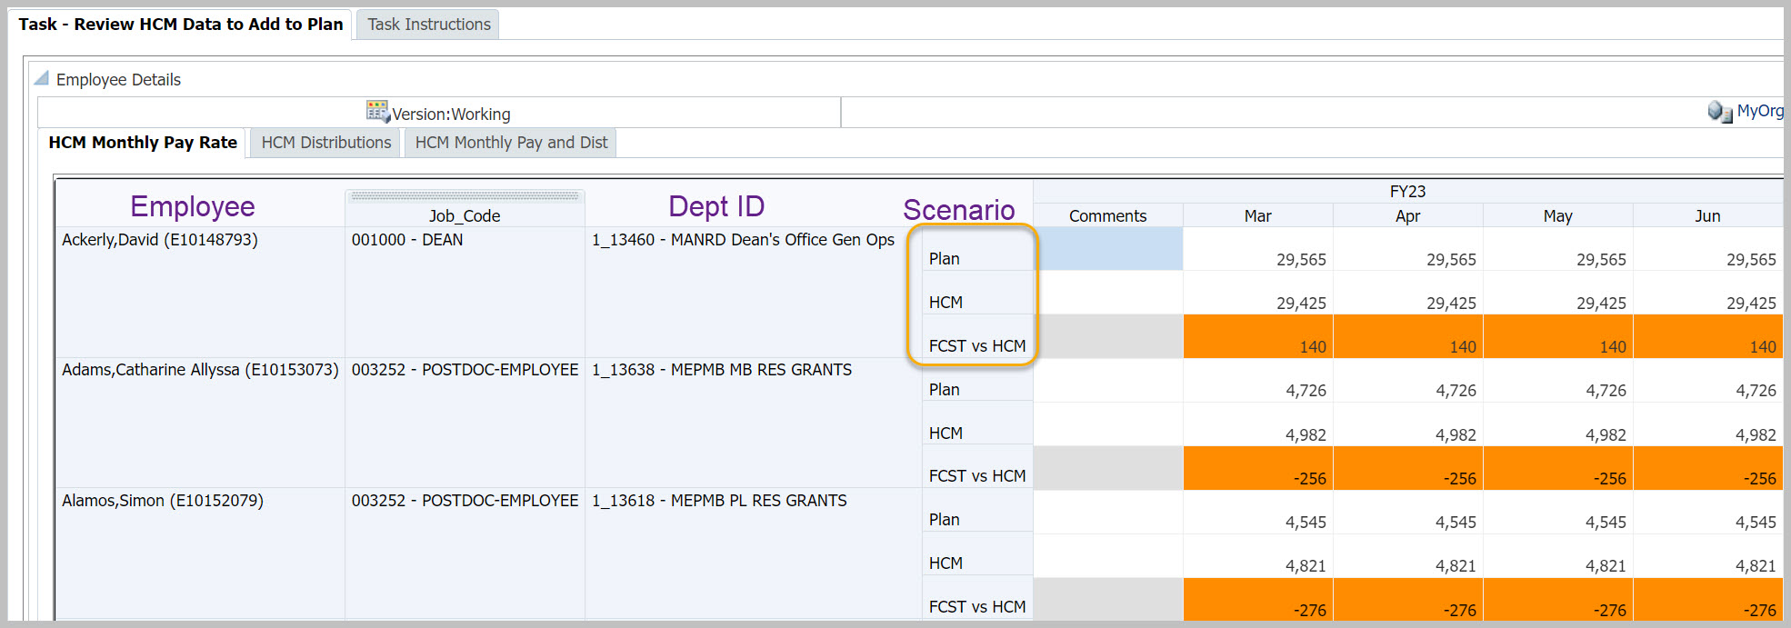
Review HCM Data to Add to Plan
Scenarios
Plan
HCM
FCST vs HCM
Plan is from Manage Existing Employees and Job Codes
HCM is from UCPath (actuals)
FCST vs HCM is the difference between Plan and HCM

Slide 55
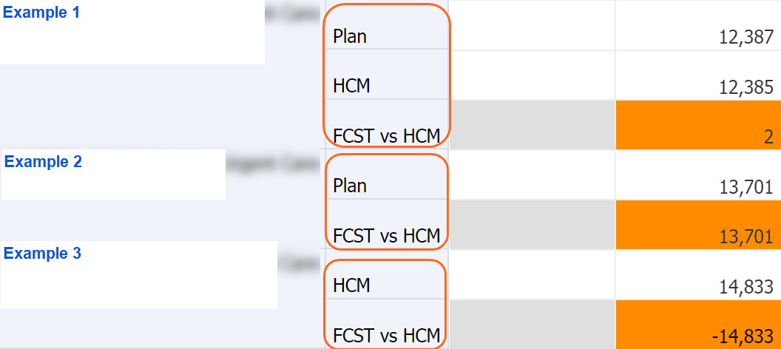
Review HCM Data to Add to Plan - Scenarios
10,300
10,450
-150
# | Scenarios | Description | Action
1 | Plan HCM FCST vs HCM | Employee is in plan and has actuals | Add data to plan if variance is material
2 | Plan FCST vs HCM | Employee is in plan but doesn’t have actuals | Delete plan data for months until actuals are expected, or all months if employee has left
3 | HCM FCST vs HCM | Employee has actuals but isn’t in plan | Add to plan

Slide 56
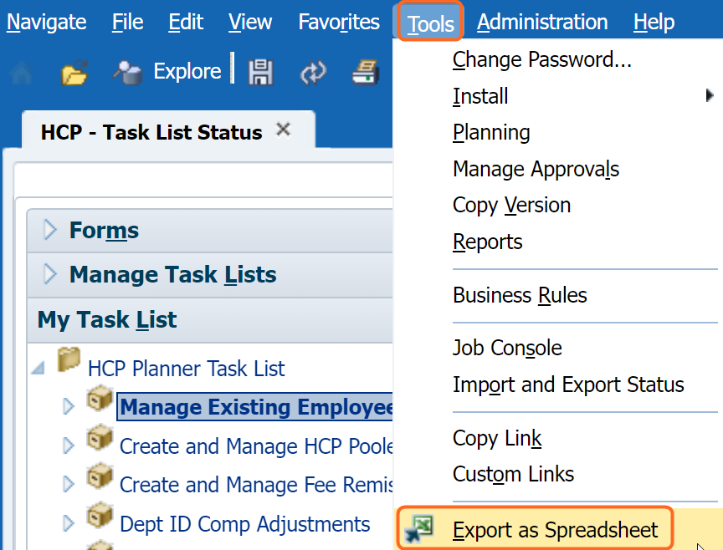
Before You Add Data to Plan
One DeptID at a time
Work with a single DeptID
You can copy data for one employee at a time or all employees in a Dept ID
If you copy all employees at a time, only those with an Employee ID are copied; To Be Hired employees are not copied
Make a backup
Make a backup of the Manage Existing Employees and Job Codes form before copying so you can refer back as needed
https://calplanning.berkeley.edu/training/job-aids

Slide 57
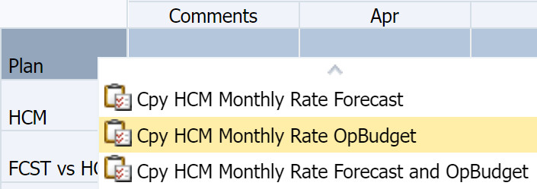
Add Data to Plan – One Employee ID
Monthly Pay Rate tab
Right-click on the Scenario column for the employee you wish to copy
Select the scenario to copy
You can copy Forecast, Operating Budget, or both

Slide 58
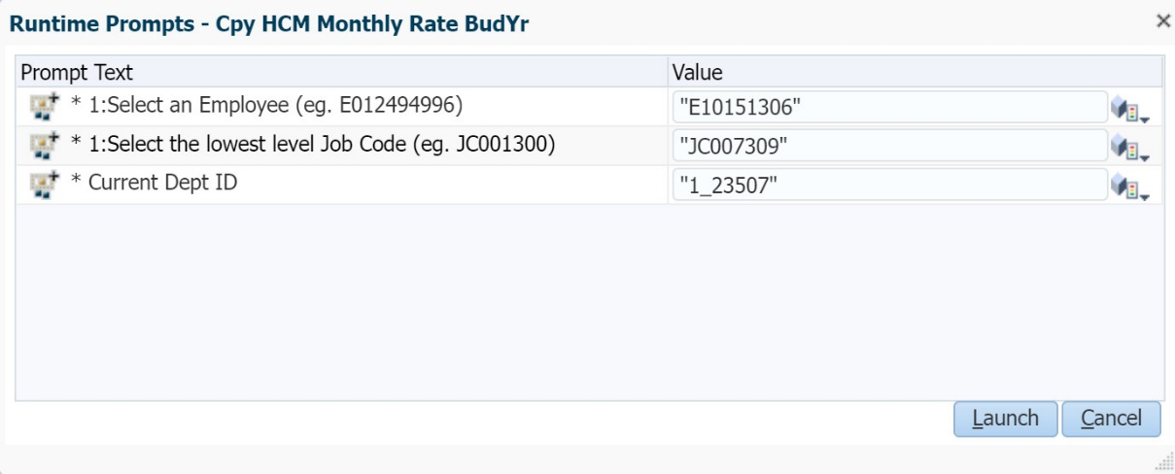
Add Data to Plan – One Employee ID
Review the values for the employee. If all is correct, click Launch.
Results
CalPlanning copies the HCM data into the Plan
See results on the Manage Existing Employees and Job Codes form
The Review HCM Data to Add to Plan form shows Plan and HCM as the same amount and a variance of zero for the employee

Slide 59
Add Data to Plan – One Employee ID – Distributions Tab
Monthly Pay Rate tab
Distributions tab
Review employee data from both tabs: HCM Monthly Pay Rate and HCM Distributions
There should be few variances on distributions
Backup before you start
Make a backup copy of the Manage Existing Employees and Job Codes form, Distributions tab, before copying so you can refer back as needed.
From the menu, select Tools / Export as Spreadsheet

Slide 60
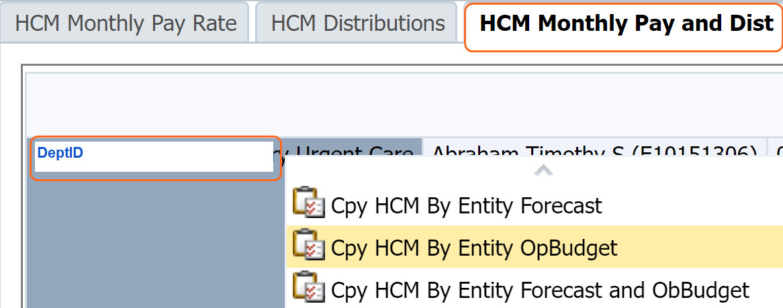
Add Data to Plan – All Employees in a DeptID
Monthly Pay and Dist tab
Right-click on the DeptID you wish to copy
Select the scenario to copy
Caution
Make a backup of the Manage Existing Employees and Job Codes form before copying so you can refer back as needed
To Be Hired employees are not copied. You will need to manually enter To Be Hired employees on the Manage Existing Employees and Job Codes form after copying all employees in a DeptID

Slide 61
Human Capital Planning (HCP) Job Aids
Compensation Drill Through Job Aid
Human Capital Planning Scenarios Job Aid
Pooled Positions Job Aid
Fee Remission Job Aid
Review HCM Data to Add to Plan Job Aid
Video: Review HCM Data to Add to Plan
Pooled Job Code Table
https://calplanning.berkeley.edu/training/job-aids

Slide 62
HCP Best Practices
DeptID Comp Adjustments should be used rarely and should not be used for To Be Hired Employees.
Make sure that compensation costs are not duplicated in these forms:
Dept ID Comp Adjustments
Manage Existing Employees and Job Codes
Notes:
DeptID Adjustments should be used rarely or as a last resort for negative comp adjustments (for example, reductions), or other comp changes (positive or negative) that either can't - or shouldn't - be attributed to an employee.

Slide 63
Online Resources
FY26 Budget Process
Release Notes
Training

Slide 64
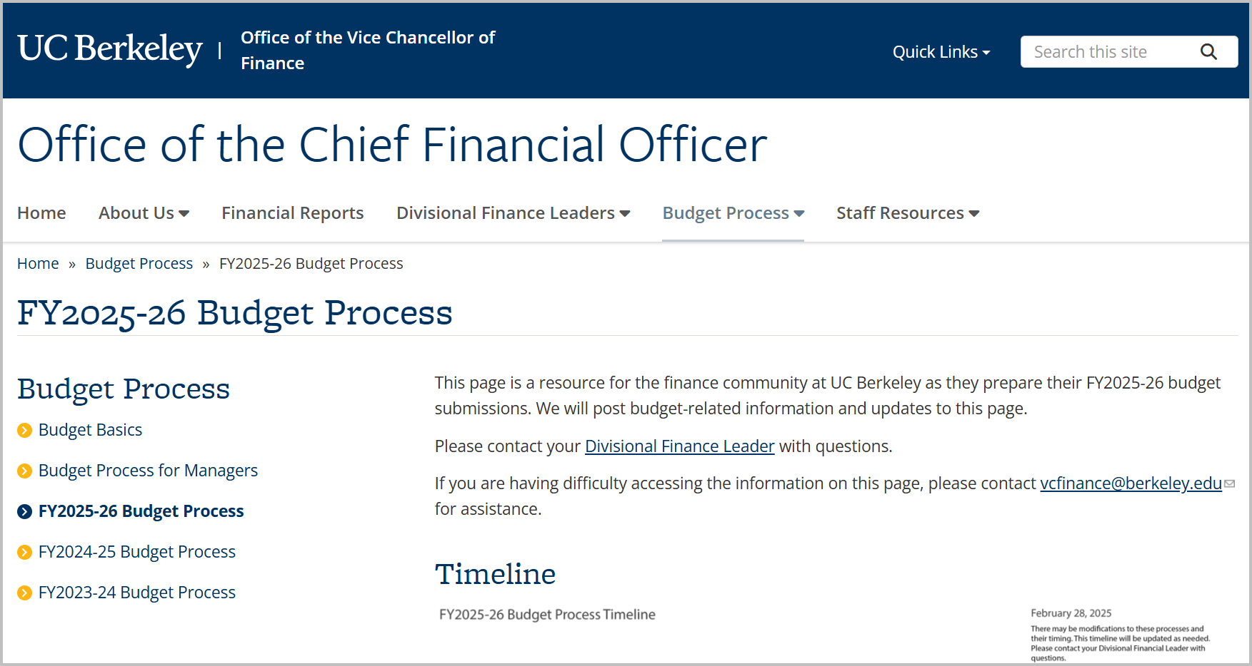
cfo.berkeley.edu
https://cfo.berkeley.edu/budget-process/fy2025-26-budget-process

Slide 65
Budget Office Hours
The Budget and Financial Operations team is hosting office hours to assist planners:
April 3, Thursday, 2:00-3:00 pm
April 11, Friday, 1:00-2:00 pm
April 15, Tuesday, 10:00-11:00 am
April 17, Thursday, 11:00-12:00 pm
Use the FY2026 Budget Office Hours Sign Up Form to select a session and submit your question.

Slide 66
Release Notes
https://calplanning.berkeley.edu/release-notes/march-2025-release-notes

Slide 67
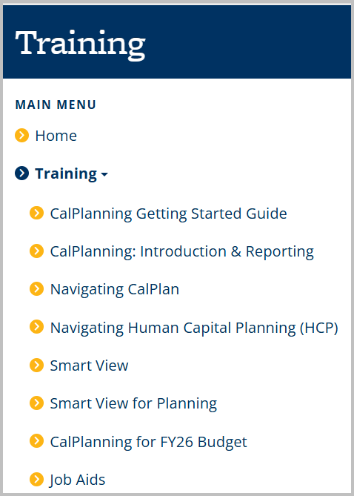
Training
https://calplanning.berkeley.edu/training

Slide 68
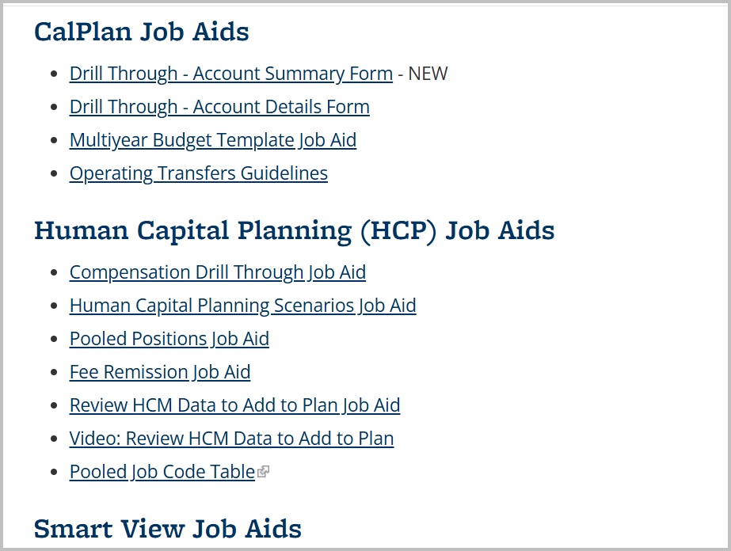
Job Aids
https://calplanning.berkeley.edu/training/job-aids

Slide 69
Thank you for your engagement.
Go Bears!

