Slide 1
FY25 CalPlanning Refresher
For experienced CalPlanning users – March 2024

Slide 2
VC Finance Subject Matter Experts
Budget and Financial Operations
Rita d’Escoto
Emily Liu
Herve Bruckert
Rocio Fragoso
Latina Kamau-Kirika
Thomas Choy
Aaron Smyth
Thomas Baza
Financial Systems
Sharon Trahan
Alfred Alipio Jocson
Haidar Alssaqaf
Dara Efron

Slide 3
Agenda
Getting Started
Key dates
Resources for learning and support
Operational updates and best practices
CalPlan
CalPlan data seeded in FY25 Operating Budget
Drill Through – Account Summary
CR127 – SRECNA Scenario Comparison with 3 years of Actuals
CalPlan Multiyear Budget Template
HCP
Composite Benefit Rates and payroll assessments
HCP data seeded in FY25 Operating Budget
HCP Manage Existing and To Be Hired Employees
Review HCM Data to Add to Plan
HCP Compensation Drill Through
Resources and Takeaways
New!
New!
New!

Slide 4
Key Dates
March 4
CalPlan and HCP available with FY25 Operating Budget updated with planning data and FY24 Forecast Working version updated with February actual data
March 15
Form A due (for divisions with ladder-rank faculty)
April 26
All budget information due in CalPlanning
FY24 Forecast updates
FY25 Operating Budget
FY26-27 in Multiyear Budget Template
Use of Reserves in Multiyear Budget Template
May 13 – June 7
Budget meetings
https://cfo.berkeley.edu/budget-process/fy2024-25-budget-process

Slide 5
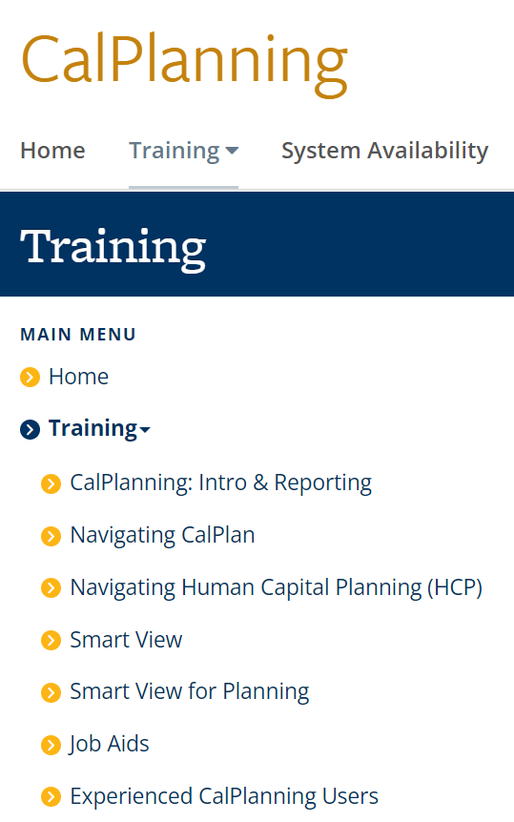
Training
Content for each class is available on the website for anyone to use at any time; no need to enroll in a class
Job aids available on topics across the curriculum
https://calplanning.berkeley.edu/training

Slide 6
Training
https://calplanning.berkeley.edu/training/budgeting-experienced-calplanning-users

Slide 7
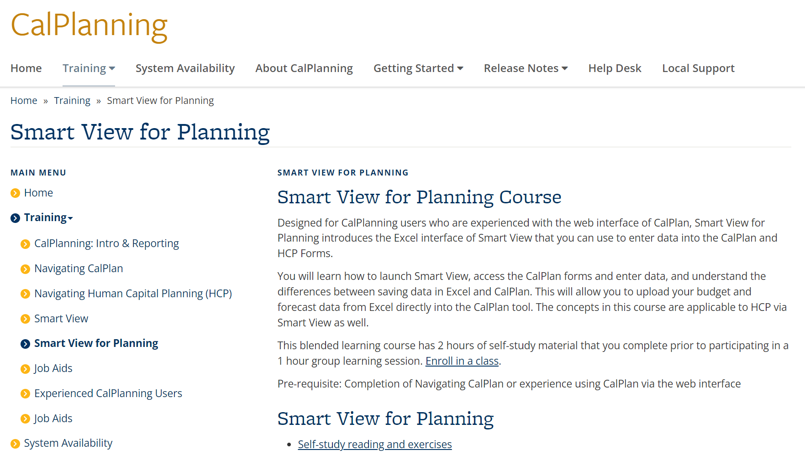

Slide 8
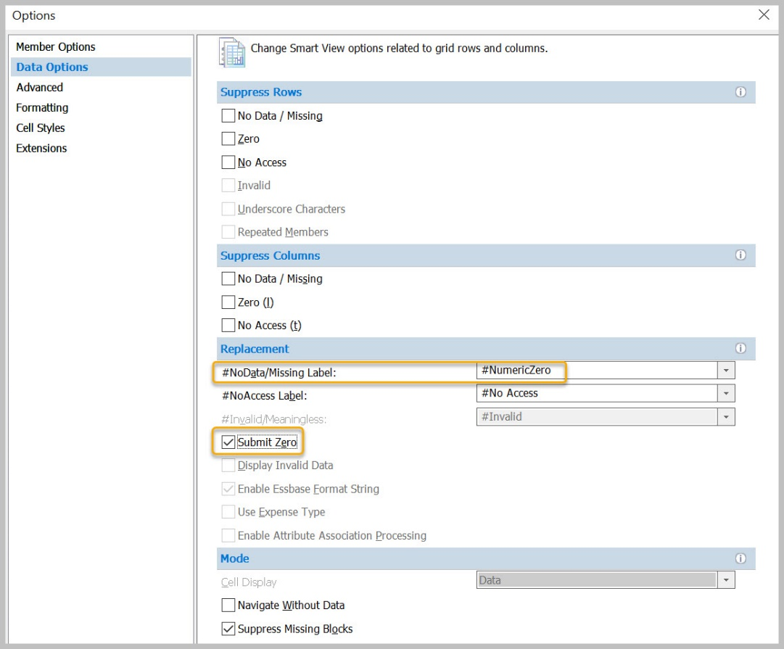
Smart View for Planning
Features and Benefits
Enter plan data into CalPlan and HCP forms in an Excel interface
Share form data with colleagues for review, make updates in Excel, and then load those changes to CalPlanning
Be sure to set Data Options:
Check Submit Zero
Do not suppress rows with no data/missing data or Zero

Slide 9
Operational Updates and Best Practices

Slide 10
Network, Browser, and Setup Requirements
Network
On Campus: Connect to Eduroam or launch via Citrix
Off Campus: Connect to GlobalProtect or launch via Citrix
Browser
Chrome, Firefox, and Edge are supported
Setup
If you are new to CalPlanning or are now using a computer that has never connected to CalPlanning before, there is some first-time setup required. CalPlanning Upgrade July 2021 Job Aid has the details.
https://calplanning.berkeley.edu/calplanning-upgrade-jul-2021-job-aid

Slide 11
Explore is the door to reports galore

Slide 12
CalPlanning Internal Data Updates

Slide 13
CalPlanning External Data Updates, Actualized Forecast
Actualized Forecast
After BFS closes the general ledger for the month, CalPlanning summarizes the actuals data and loads it to Forecast Working. The actuals data replace what was present and the month is no longer editable.
FY2023-24 Forecast Working version will be updated with February actual data on Thursday morning March 14 between 6 am and 9 am
https://calplanning.berkeley.edu

Slide 14
Membership Funds Moved
from Contracts & Grants to Sales & Service
Effective November 1, 2023, thirty-five membership funds were transferred from the C&G fund group to the Sales and Services fund group.
Funds moved from Contracts & Grants to Sales & Services effective 11/1/2023
25584, 25900, 58125, 59297, 59822, 59989, 62871, 63479, 78452, 85458, 85988, 85989, 86129, 86169, 86199, 86215, 86260, 86264, 86337, 86340, 86436, 86439, 86449, 86459, 86469, 86499, 94210, 94213, 94990, 96150, 96200, 96360, 96438, 96477, 96498

Slide 15
CalPlan
Dept ID Inactivation
CalPlan data seeded in FY25 Operating Budget
Central transfers and commitments
Drill Through-Account Summary Form
Multiyear Budget Template

Slide 16
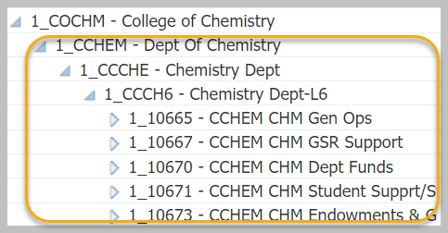
Recommended Org Level Settings
To ensure optimal performance for all users, please use L4, L5, L6, or L7 (Dept ID)

Slide 17
DeptID Inactivation
DeptIDs are set to read-only in CalPlan
DeptIDs are removed from CalPlan when there is no more activity
Actuals remain in the original entity but the Forecast and Operating Budget amounts have been moved to the mapped entity.
For the list of already inactive DeptIDs as well as DeptIDs planned for inactivation, go to the Planning DeptID Inactivation webpage
https://cfo.berkeley.edu/divisional-finance-leaders/dfl-concierge/organizational-tree/request-org-tree-changes/deptid-planned

Slide 18
CalPlan Data Seeded in FY25 Operating Budget

Slide 19
Data Seeded in the FY25 Operating Budget
In October 2023, FY24 Operating Budget Final was copied to FY25 Operating Budget Working. See the release notes for details.
FY25 Operating Budget Working includes all of the updates that planners made through Feb 6, 2024.
Central Transfers & Commitments have distributed to the units for the FY25 Operating Budget Working.
https://calplanning.berkeley.edu/release-notes/october-2023-release-notes

Slide 20
Central Transfers and Commitments – General Allocation
71110 General Allocation
71290 OP Allocations
75101 Dept – Initial Transfers
FY25 seeded with permanent budget data
to the C1_GENALC general allocation Chart1 member

Slide 21
Central Transfers and Commitments - Campus Support
Campus Support
712xx
713xx
714xx
Updated with most recent commitments data for open periods in FY24 and FY25
Notes
Inclusion in the commitment database does not guarantee future funding. All amounts are subject to change.
Form A Accounts in the 71xxx series have been cleared and will be updated again later this month with Form A data provided by the DFLs for both planning years to the C1_FORMA1 and C1_FORMA2 Form A Chart1 members.
Central transfers were loaded to new CalPlan-only Chart1 members. These are the Chart1 members used only in CalPlanning; they will not be used for the Actuals journals.
Chart1 | Used for
C1_GENALC | General allocations
C1_FORMA1 C1_FORMA2 | Form A data submitted by DFLs

Slide 22
Central Transfers and Commitments - Regents Endowment / FFE
72210 Regents Endowment / FFE
FY25 Operating Budget is FY24 actual payout increased by 2%
Fund performance information from University Development and Alumni Relations (UDAR) is available in the FY2024-25 Operating Budget Guidelines for potential planner adjustments

Slide 23
CalPlan Best Practice
Check for intersections (Chartfield1, Fund, Dept ID) have seeded amount copied over from FY24 budget that you need to clear for FY25 budget

Slide 24
CalPlan: Drill Through – Account Summary Form

Slide 25
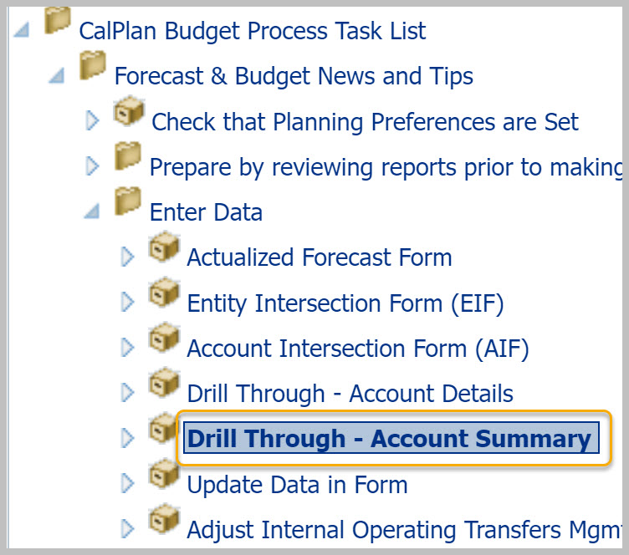
Drill Through – Account Summary Form
Quickly and easily toggle between:
High-level review
Detail level for data entry
Enter summary plan data by quarter or year and CalPlan spreads to months for you

Slide 26
Drill Through – Account Summary Form Start from a high-level in your organization
Start from a high-level in your organization, e.g. Division (L3) or Department (L4)

Slide 27
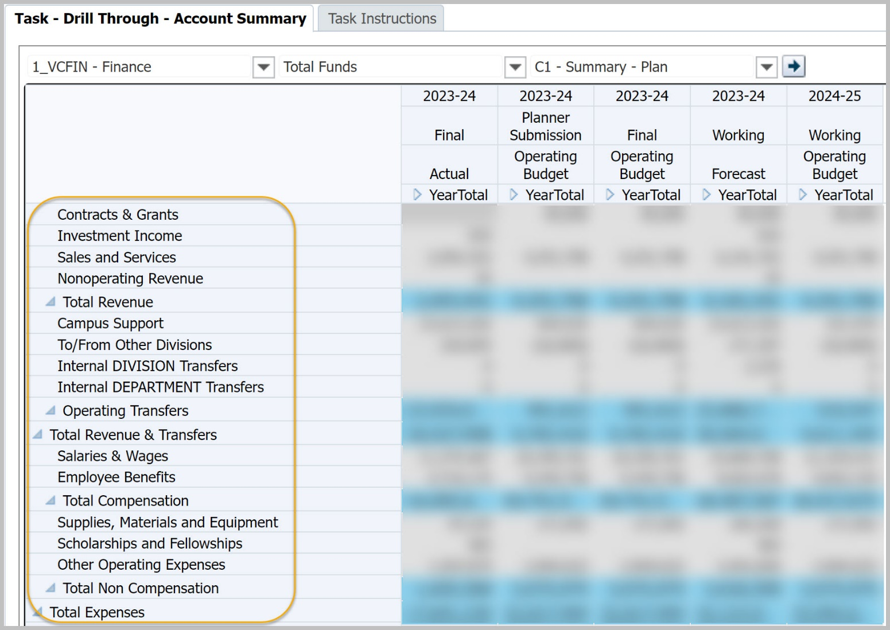
Drill Through – Account Summary Form Start from a high-level in your organization
Displays high-level accounts summarized by year, scenario and version

Slide 28
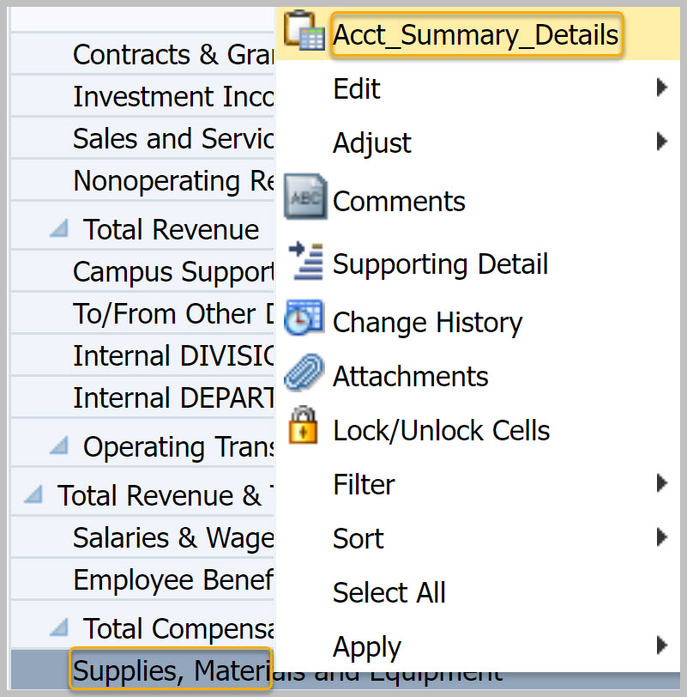
Drill Through – Account Summary Form Drill down to detailed data for an account
1. Right-click on the account
2. Select Acct_Summary_Details from the context sensitive menu

Slide 29
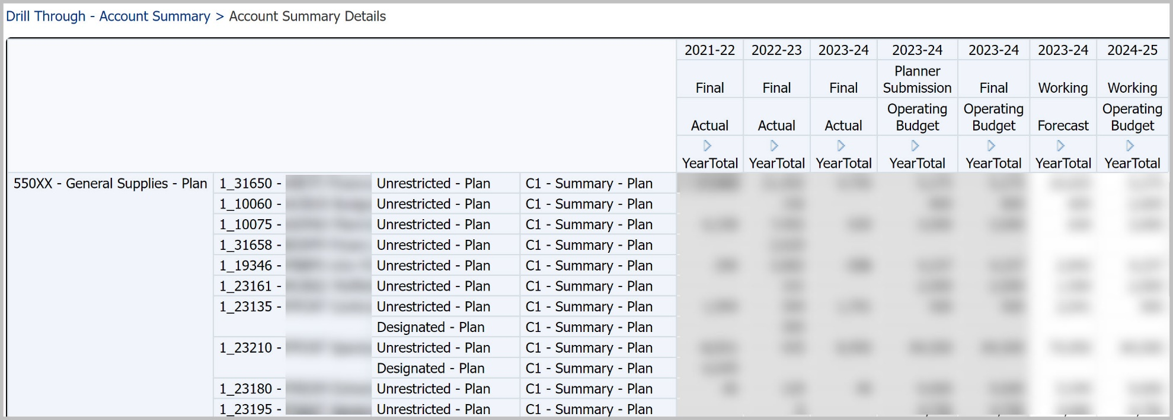
Drill Through – Account Summary Form Account Summary Details
The Account Summary Details form presents one row for each unique combination of planning account, DeptID, fund bucket, and Chart1.

Slide 30
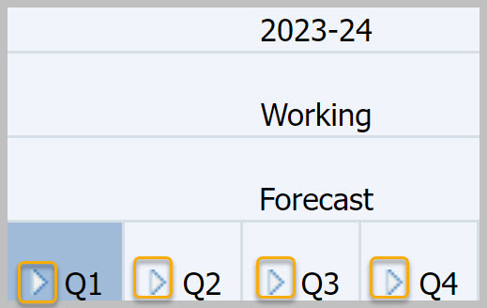
Drill Through – Account Summary Form Expand Year, Scenario, and Version to display months
The period for each combination of year, scenario and version is summarized by YearTotal. You can expand these columns by selecting the right facing triangles.

Slide 31
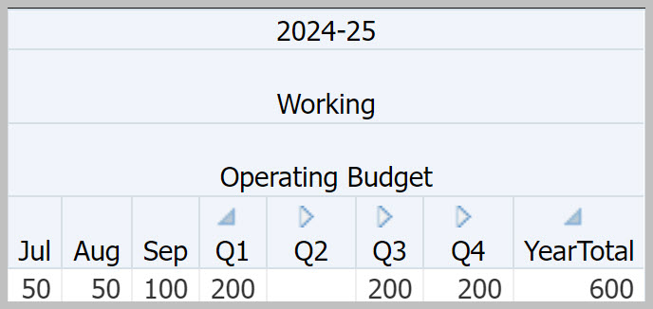
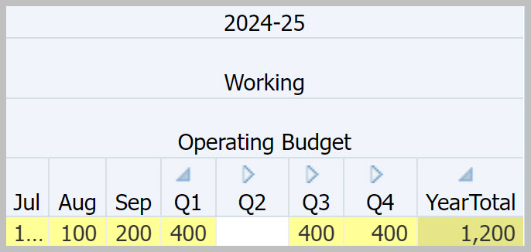
Drill Through – Account Summary Form Enter Data in Quarter or YearTotal
Enter data in a summary period (quarter or YearTotal)
Your unit is increasing its budget for general supplies from $600 to $1,200 for the year so you enter $1,200 in YearTotal
CalPlan spreads the amounts to the months
The amounts for Jul, Aug, and Sep were doubled from $50, $50, and $100 to $100, $100, and $200. Dollars are spread proportionally

Slide 32
Drill Through – Account Summary Form Return to Account Summary Form
Use the breadcrumb links at the top of the form to navigate between the Account Summary and Account Summary Details views

Slide 33
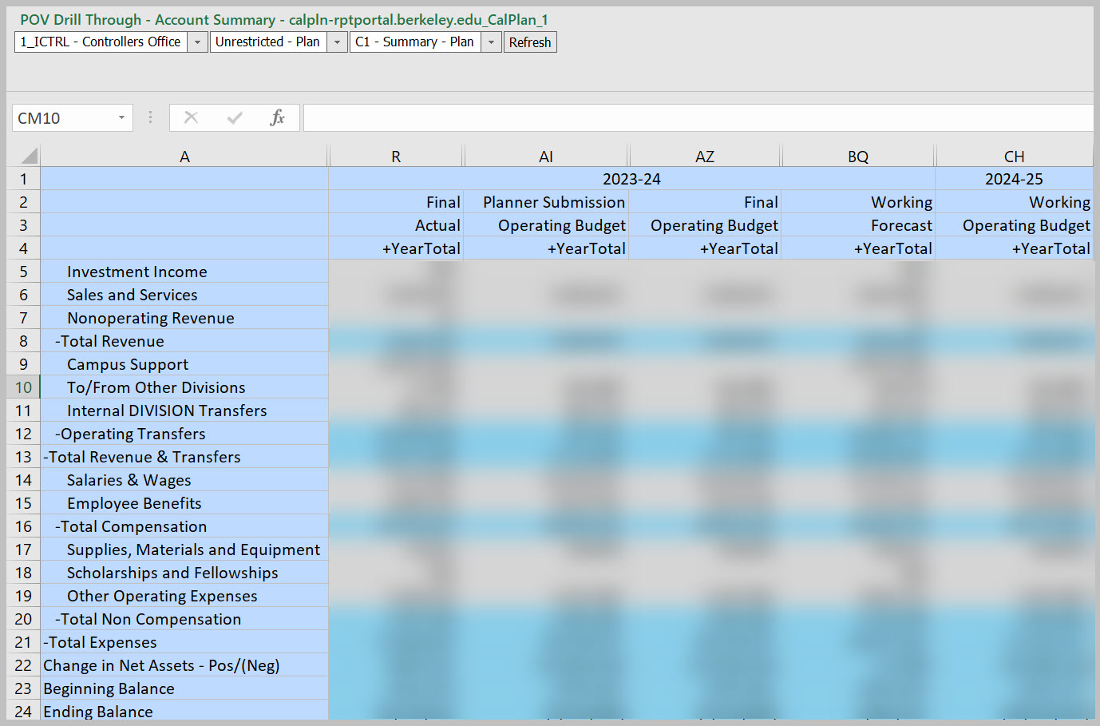
Drill Through – Account Summary Form Form Available in Smart View for Planning

Slide 34
New CalRptg Report Template: SRECNA Scenario Comparison with 3 years of Actuals
CalRptg Report CR127
Developed in partnership with the College of Letters & Science, CR127 expands on the existing CR107 SRECNA 3 Year Scenario Comparison and CR120 SRECNA reports by including three prior years of Actuals and calculates year-over-year variances based on the average of those three-years’ worth of Actuals.
This report helps planners acquire a longitudinal view of their unit’s spending over time.

Slide 35
CR127 – SRECNA Scenario Comparison with 3 years of Actuals
Combining the best of:
CR107 SRECNA 3 Year Scenario Comparison
CR120 SRECNA Trend
CR127 - SRECNA Scenario Comparison compares the average of three years of Actuals to the forecast and operating budget.

Slide 36
Human Capital Planning (HCP)
Set org level
Rates for benefits and fee remission
Data seeded in HCP FY25 Operating Budget
Planning for Existing and To Be Hired Employees
Review HCM data to add to HCP
New: Compensation Drill Through

Slide 37
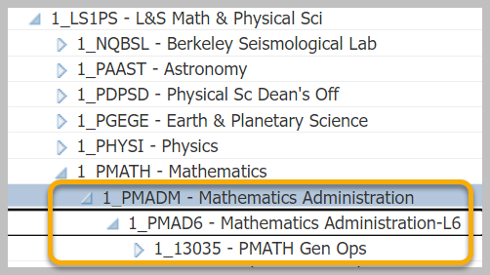
Recommended Org Level Settings
To ensure optimal performance for all users, please use L5, L6, or L7 (Dept ID)

Slide 38
Composite Benefit Rates

Slide 39
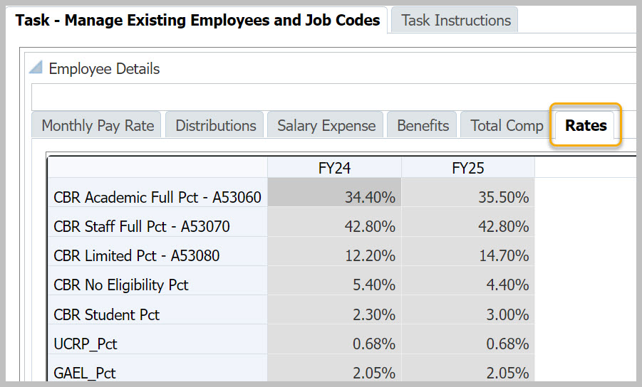
Composite Benefit Rates
Since implementing UCPath, we follow a standard process for calculating rates led by UCOP and will adopt their agreements with the federal government. See Composite Benefit Rate webpage for more information on the calculation.
FY25 rates are for planning purposes only. We will not know the final rates until later this year. FY24 Rates used for planning 4/10/23 – 2/4/24.
https://cfo.berkeley.edu/about-us/financial-planning-analysis/budget-and-financial-operations/composite-benefit-rates-cbr

Slide 40
Fee Remission Rates

Slide 41
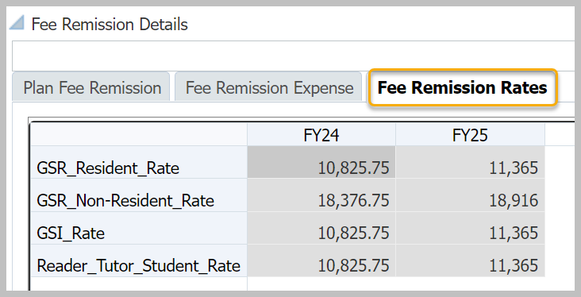
Fee Remission Rates
FY24 fee remission updated in HCP on October 17, 2023
FY24 rates used for planning from 10/17/23 through 2/4/24
FY25 fee remission added in HCP on March 1, 2024
https://calplanning.berkeley.edu/navigating-human-capital-planning-hcp/fee-remission

Slide 42
HCP Data Seeded in FY25 Operating Budget

Slide 43
HCP FY24 Forecast Copied to FY25 Operating Budget
Monthly Pay Rates
Copied with a 4.2% increase over FY24 Jun pay rate for:
Individually-planned employees
To Be Hired employees
Increase amounts vary by union; see Release Notes for details
Pooled Positions
Increased by 4.2% over FY24
See the job code-to-pooled position mapping file
DeptID Comp Adjustments
Not copied to FY25
https://calplanning.berkeley.edu/release-notes/march-2024-release-notes

Slide 44
Planning for Existing and To Be Hired Employees
Forms and processes to help you plan for existing and to be hired employees:
Create Backups
Compare HCP to your budget
Review HCM Data
Update employees with changes
To Be Hired Employees
Create backups
Save backup copies of Monthly Pay Rate and Distributions tabs on the Manage Existing Employees and Job Codes task.
Compare HCP to your budget
Compare Compensation Drill Through to your offline salary expense by employee. Edit Employee Details in Monthly Pay Rate and Distributions tabs as needed.
Review HCM Data
to Add to Plan one Dept ID at a time. Brings data from UCPath into CalPlanning.
Update employees with changes
Update Manage Existing Employees and Job Codes Monthly Pay Rate and Distributions tabs for employees who will leave or change job code, DeptID, fund type, or Chart1.
To Be Hired Employees
Confirm that To Be Hired employees reflect the open positions in UCPath that the team intends to fill. If you Added HCM Data to Plan for all employees in a DeptID, you will need to re-enter the data for the To Be Hired employees. Refer to the backup copies you made at the start of the process.

Slide 45
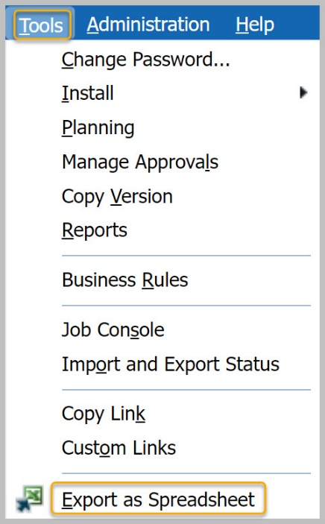
Backup HCP Data
Backup from the Manage Existing Employees and Job Codes task:
Monthly Pay Rate
Distributions
From the menu, select Tools / Export as Spreadsheet

Slide 46
Review HCM Data to Add to Plan

Slide 47
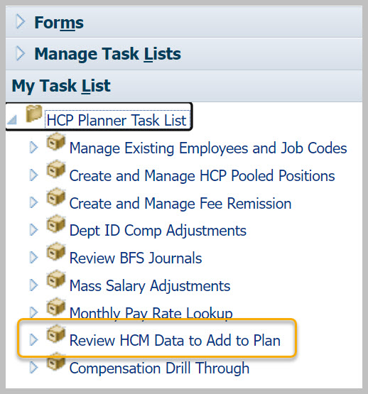
Review HCM Data to Add to Plan
Task and form helps you update your plan with:
Current and future pay rates and distributions for existing employees
New hires and transfers into your department
Employees who have left your department and should be removed from your plan

Slide 48
FY25 Salary increases and timing in Review HCM data to add to plan
Employee Type | Union Code | FY25 Monthly Pay Rate Increase
Ladder-Rank Faculty | A1 & A2 | 4.2% range adjustment eff Oct 1 (subject to change, contingent on State support)
Non-Represented |  | 4.2% increase eff Jul 1 (subject to change, contingent on State support)
CX - Clerical & Allied Services | CX | 4.2% incr plus a step incr eff Jul 1
IX - Non-Senate Instructional LX - Professional Librarians RA - Academic Researchers RX - Research Support Professionals | IX LX RA RX | 3% incr eff Jul 1
PA - Police Officers | PA | 4% incr plus 1% retention incr eff Jul 1
GS - Berkeley Printing Trades KB - Berkeley Skilled Craft | GS KB | 4% incr eff Oct 1
DX - Student Health Phys & Dentists | DX | 3% incr plus 1% equity incr eff Oct 1
HX - Residual Health Care Prof TX - Technical | HX TX | 3% incr eff Jul 1; step incr eff Jan 1
SX - Service | SX | step incr eff Jul 1; 3% incr eff Oct 1
NX - Registered Nurses | NX | step incr eff Jul 1; 5% incr eff Jan 1
EX - Patient Care Technical | EX | step incr eff Jul 1; 3% incr eff Apr 1
PX - Post Doctoral Scholars | PX | The new salary scales can be found on this UCOP website, Table 23.
Notes:
Monthly FY25 pay rates were increased by percentage and timing indicated in the chart.
Salaries for employees paid over 10 months corrected to remove the need for manual salary adjustments. HCP spreads annual salaries over 12 months. Employees with ‘1/10’ in their titles had their annual salary multiplied by 12/10 so that the 12-month spread and annual salary are correctly calculated.
Employees with end dates were extended, except contract appointment employees and employees who separated or were on unpaid leave before 2/1/2024.
BX - Academic Student Employees & BR - Graduate Student Researchers employees are in pooled positions. See the Current Rates (BX) website for salary scale information.
In cases where a union contract is expiring, the salary increase from the prior year is planned forward for budgeting purposes. You may need to update your budget plan as new union contracts are negotiated and ratified.

Slide 49
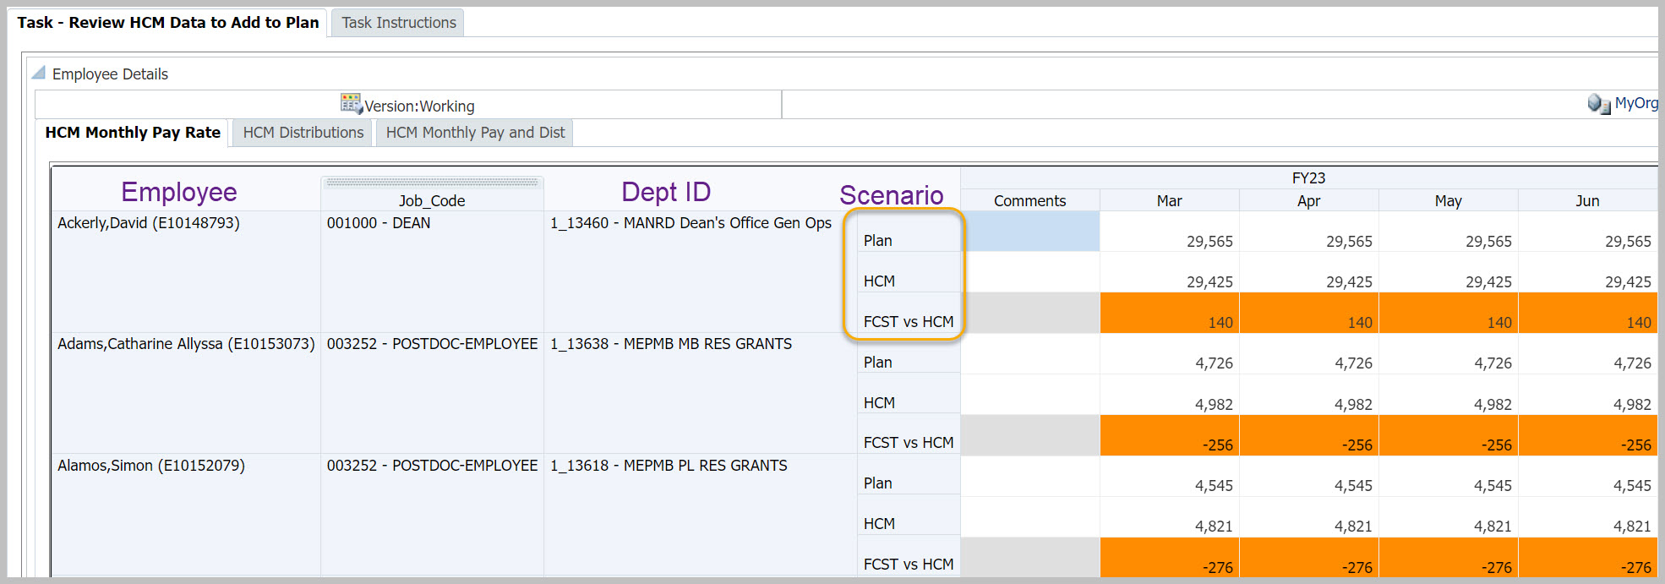
Review HCM Data to Add to Plan
Scenarios
Plan
HCM
FCST vs HCM
Plan is from Manage Existing Employees and Job Codes
HCM is from UCPath (actuals)
FCST vs HCM is the difference between Plan and HCM

Slide 50
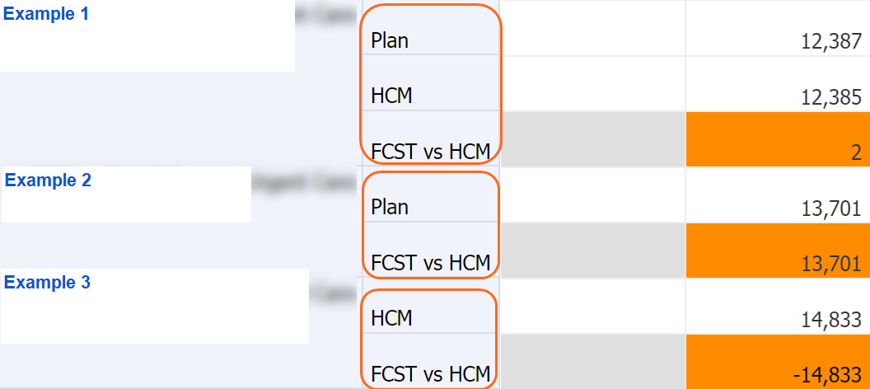
Review HCM Data to Add to Plan - Scenarios
10,300
10,450
-150
# | Scenarios | Description | Action
1 | Plan HCM FCST vs HCM | Employee is in plan and has actuals | Add data to plan if variance is material
2 | Plan FCST vs HCM | Employee is in plan but doesn’t have actuals | Delete plan data for months until actuals are expected, or all months if employee has left
3 | HCM FCST vs HCM | Employee has actuals but isn’t in plan | Add to plan

Slide 51
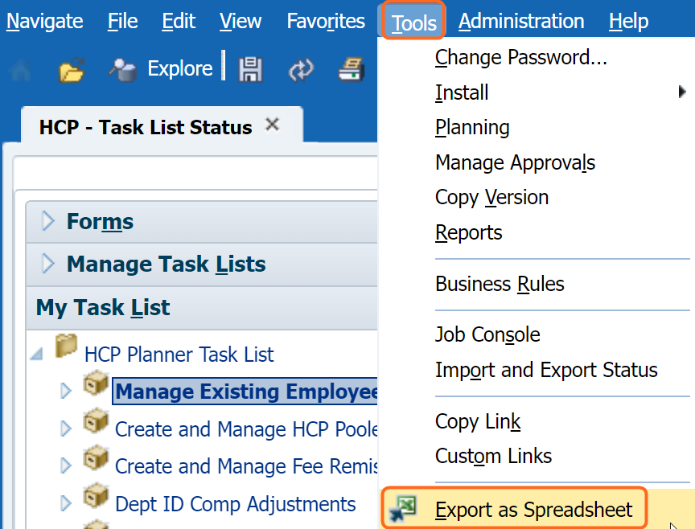
Before You Add Data to Plan
One DeptID at a time
Work with a single DeptID
You can copy data for one employee at a time or all employees in a Dept ID
If you copy all employees at a time, only those with an Employee ID are copied; To Be Hired employees are not copied
Make a backup
Make a backup of the Manage Existing Employees and Job Codes form before copying so you can refer back as needed
https://calplanning.berkeley.edu/training/job-aids

Slide 52
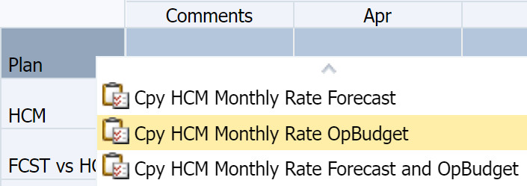
Add Data to Plan – One Employee ID
Monthly Pay Rate tab
Right-click on the Scenario column for the employee you wish to copy
Select the scenario to copy
You can copy Forecast, Operating Budget, or both

Slide 53
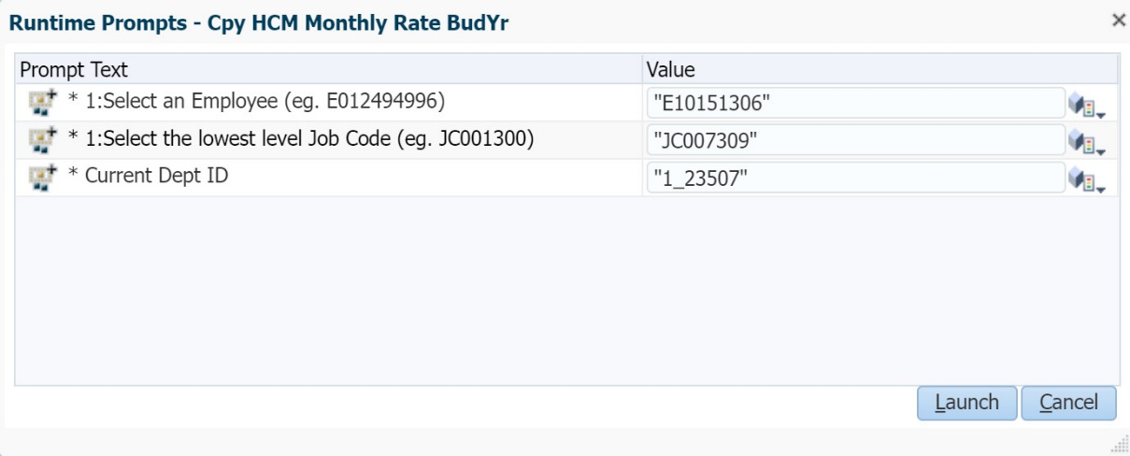
Add Data to Plan – One Employee ID
Review the values for the employee. If all is correct, click Launch.
Results
CalPlanning copies the HCM data into the Plan
See results on the Manage Existing Employees and Job Codes form
The Review HCM Data to Add to Plan form shows Plan and HCM as the same amount and a variance of zero for the employee

Slide 54
Add Data to Plan – One Employee ID – Distributions Tab
Monthly Pay Rate tab
Distributions tab
Review employee data from both tabs: HCM Monthly Pay Rate and HCM Distributions
There should be few variances on distributions
Backup before you start
Make a backup copy of the Manage Existing Employees and Job Codes form, Distributions tab, before copying so you can refer back as needed.
From the menu, select Tools / Export as Spreadsheet

Slide 55
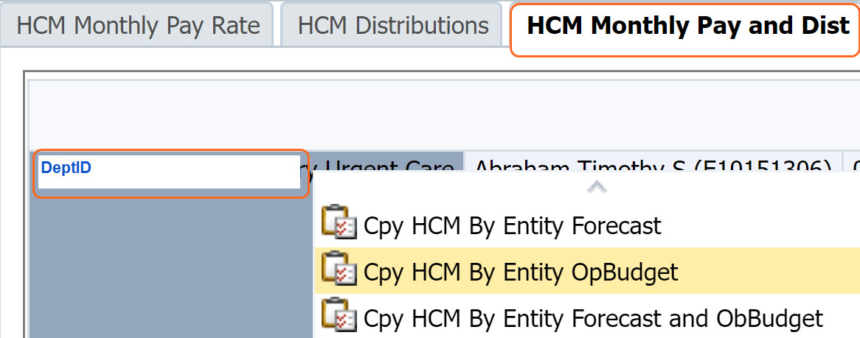
Add Data to Plan – All Employees in a DeptID
Monthly Pay and Dist tab
Right-click on the DeptID you wish to copy
Select the scenario to copy
Caution
Make a backup of the Manage Existing Employees and Job Codes form before copying so you can refer back as needed
To Be Hired employees are not copied. You will need to manually enter To Be Hired employees on the Manage Existing Employees and Job Codes form after copying all employees in a DeptID

Slide 56
Human Capital Planning (HCP) Job Aids
Compensation Drill Through Job Aid
Human Capital Planning Scenarios Job Aid
Pooled Positions and Fee Remission Job Aid
Review HCM Data to Add to Plan Job Aid
Video: Review HCM Data to Add to Plan
Pooled Job Code Table
https://calplanning.berkeley.edu/training/job-aids

Slide 57
HCP Compensation Drill Through

Slide 58
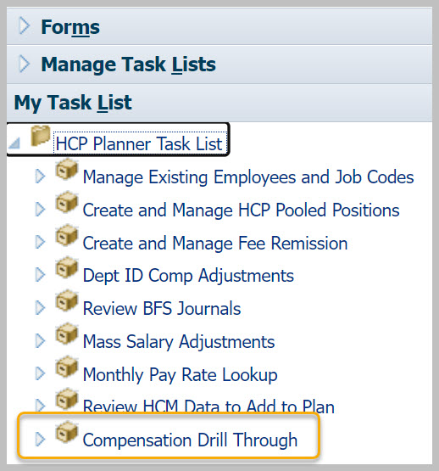
HCP Compensation Drill Through
Use the Compensation Drill Through form to:
View your data beginning at a summary level
Drill down to detailed data
Return to summary level
While viewing detailed data at the employee level, you can make updates if needed.

Slide 59
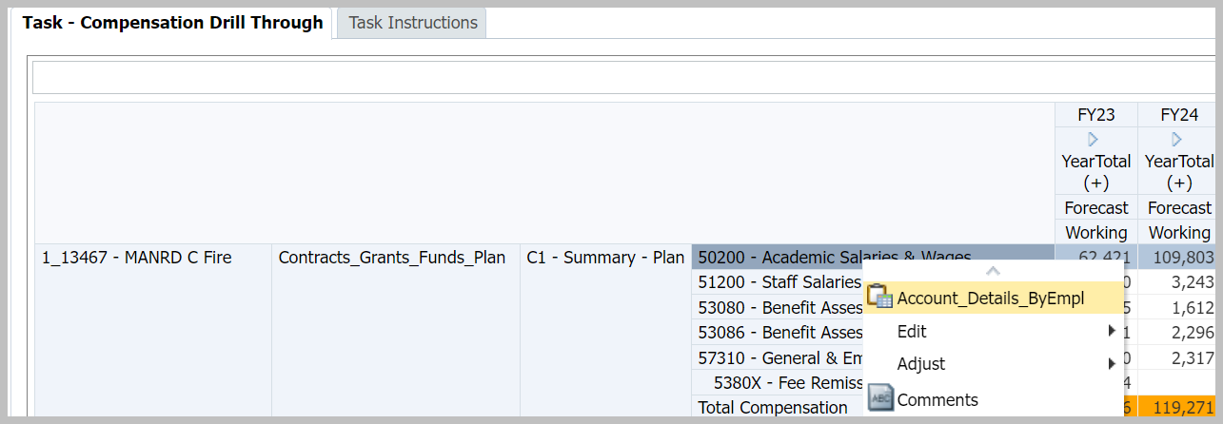
HCP Compensation Drill Through
Form shows summary level data by DeptID, Fund bucket, CF1, and Compensation Account
To see details, right-click on an account and select Account_Details_ByEmpl

Slide 60
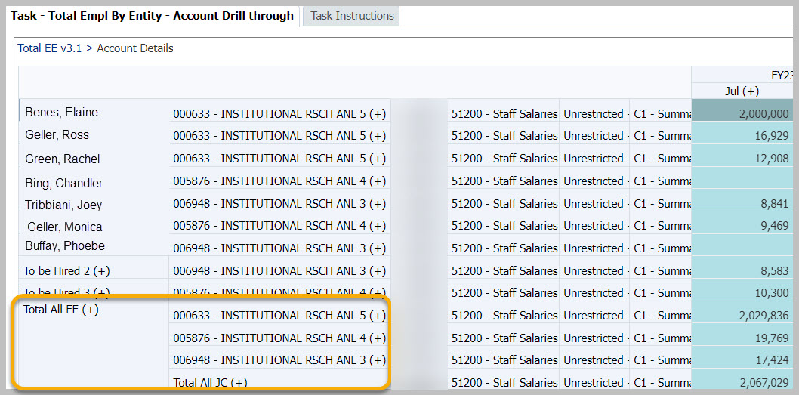
HCP Compensation Drill Through – Account Details
Account Details presents:
List of all employees
Summary of employees by job code
Summary of all job codes

Slide 61
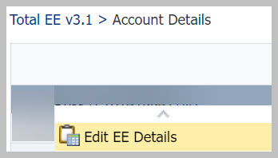
HCP Compensation Drill Through – Edit Employee Details
To see details about an employee, right-click on the employee name and select Edit EE Details
Edit Employee Details is context sensitive
When you right-click on Pooled Positions and select Edit EE Details, HCP takes you to the Create and Manage HCP Pooled Positions task.
When you right-click on Dept ID Comp Adjustments and select Edit EE Details, HCP takes you to the Dept ID Comp Adjustments task.

Slide 62
HCP Compensation Drill Through Employee Details Drill Through
The Employee Details Drill Through form has six tabs:
You can make edits in the Monthly Pay Rate and Distributions tabs, just as you would on the Manage Existing Employees and Job Codes form
You cannot make edits in the DT Salary Expense, DT Benefits, and DT Total Comp tabs because they are calculated values

Slide 63
HCP Compensation Drill Through Employee Details Drillthrough – Return to Summary
Use the breadcrumb links in the upper left to navigate between detail and summary views

Slide 64
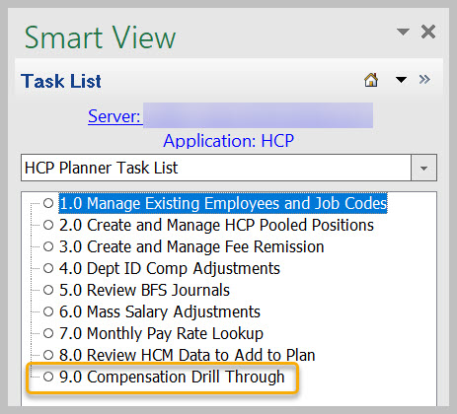
HCP Compensation Drill Through Form is available in Smart View for Planning
Connect to Smart View for Planning and display the task list

Slide 65
HCP Best Practices
DeptID Adjustments should be used rarely and should not be used for To Be Hired Employees.
Make sure that compensation costs are not duplicated in these forms:
Dept ID Comp Adjustments
Manage Existing Employees and Job Codes
When an employee has distributions split across different divisions, make sure you talk to each other to plan it correctly in HCP
Notes:
DeptID Adjustments should be used rarely or as a last resort for negative comp adjustments (for example, reductions), or other comp changes (positive or negative) that either can't - or shouldn't - be attributed to an employee.

Slide 66
CalPlan: Multiyear Budget Template

Slide 67
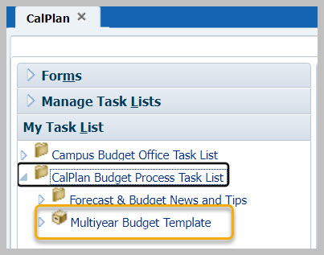
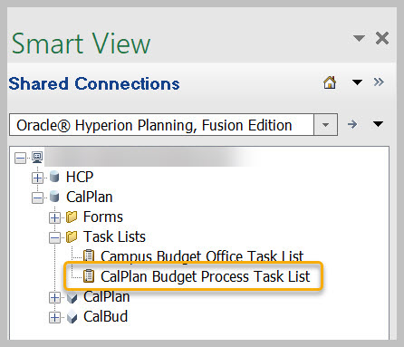
Multiyear Budget Template
The Multiyear Budget Template is available in:
CalPlan on the web | Smart View for Planning - CalPlan
https://calplanning.berkeley.edu/multiyear-budget-template-job-aid

Slide 68
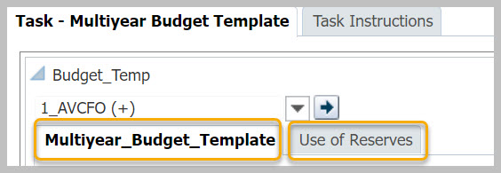
Multiyear Budget Template
The Multiyear Budget Template has two tabs:
Multiyear Budget Template
Use of Reserves

Slide 69
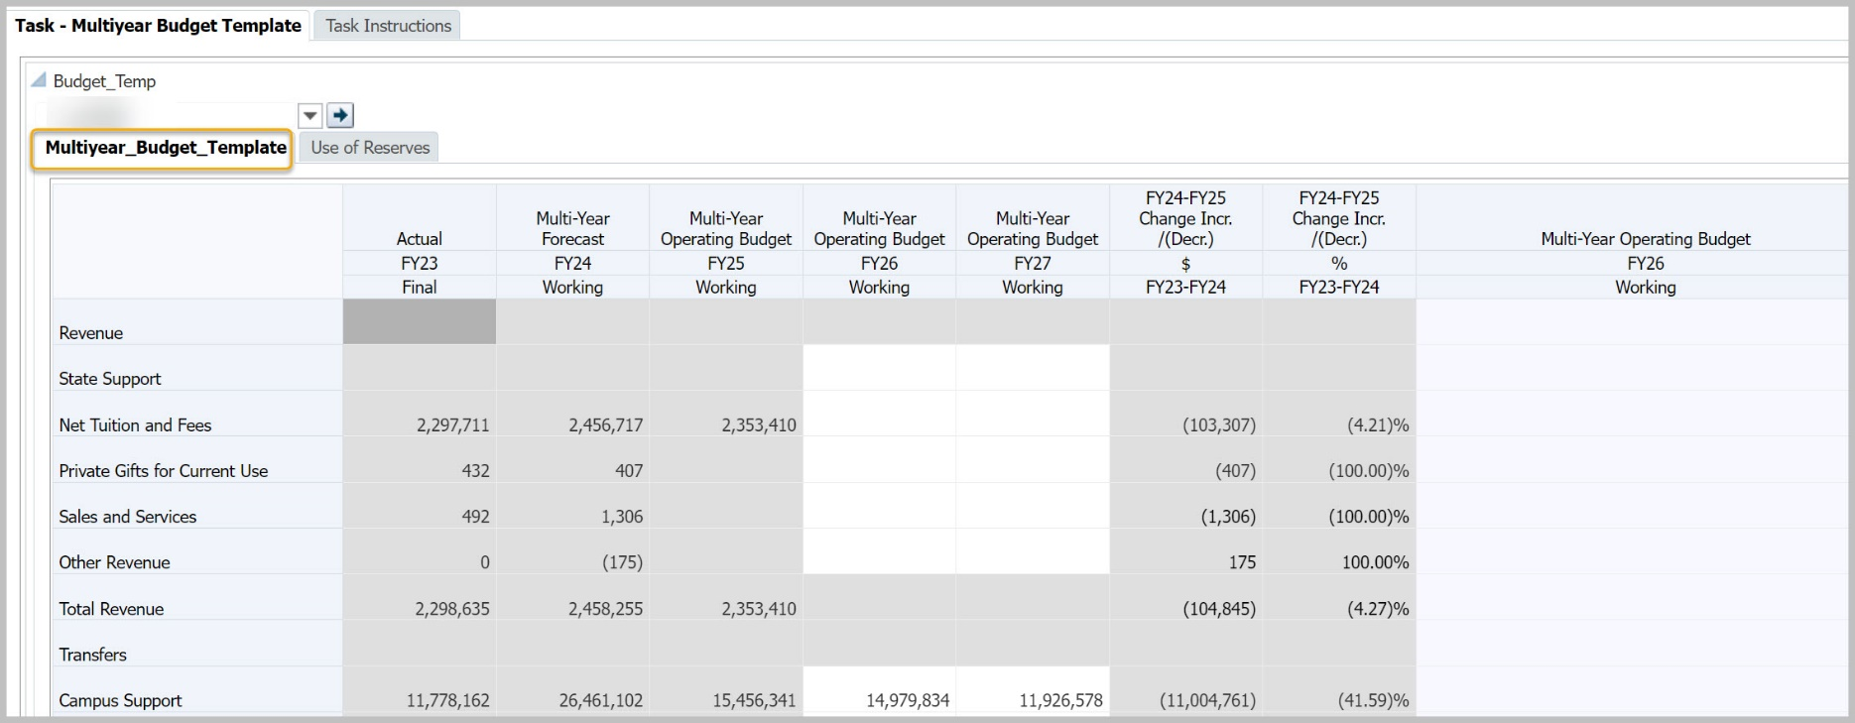
Multiyear Budget Template
Data from FY23-25 is loaded from CalPlan forms
Planners enter data for FY26 and FY27 at L4 Department level
If you would like to enter data at the L3 Division level, select an L4 Department and enter all data there

Slide 70
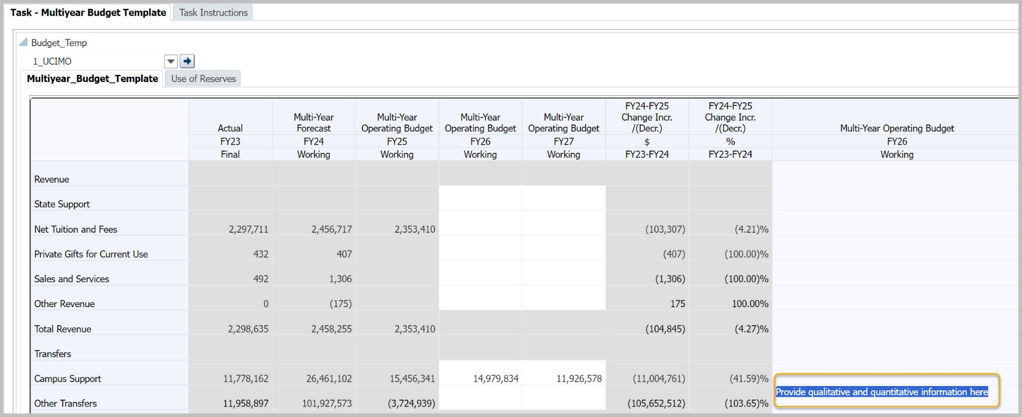
Multiyear Budget Template - Comments
Enter Comments in last column on the right: Multi-Year Operating Budget FY26 Working

Slide 71
Multiyear Budget Template - Save
Select the Save button to save to CalPlanning

Slide 72
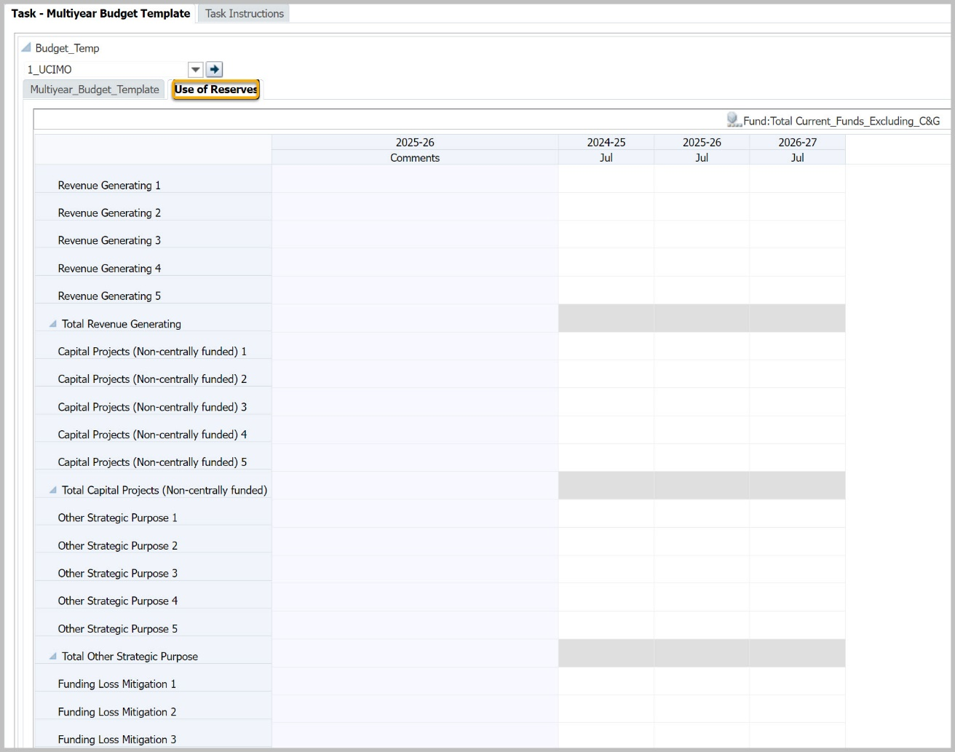
Use of Reserves
The Use of Reserves tab allows planners to show how the organization plans to spend reserves. To keep submissions at a high level, there is a limit of five rows for each category of reserve spending:
Revenue Generating
Capital Projects
Other Strategic Purpose
Funding Loss Mitigation

Slide 73
Use of Reserves: Save
Use the Save button to save your numbers and comments to CalPlanning

Slide 74
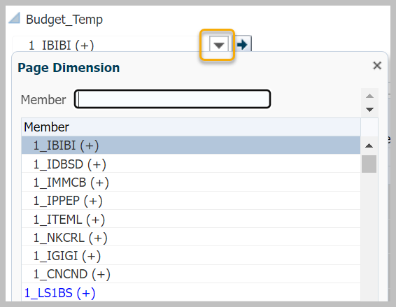
Use of Reserves: Review at Summary Level
To view data at the Division level, open the Entity drop-down and select Division.
Then click the Go button to refresh the data.

Slide 75
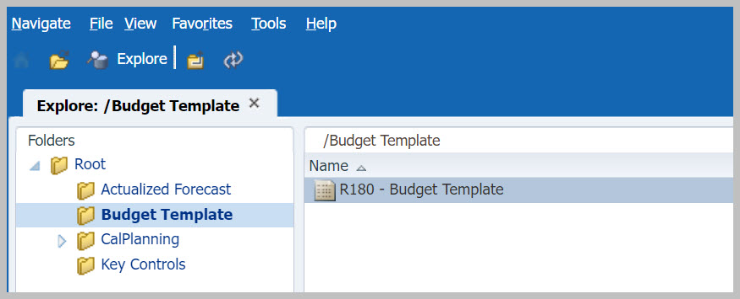
R180 Budget Template
The CalPlan R180 Budget Template allows you to generate a report showing data for multiple entities so you can see department and division entries, each on their own page.

Slide 76
R180 Budget Template - Respond to Prompts
Respond to Prompts is where you select the entities to include in the report; they can be L4 Departments or L3 Divisions.
If you know the member names, check Edit Member Names and type the entities in the Selection box.
If you prefer to select members from the tree, click the Member Selection button.

Slide 77
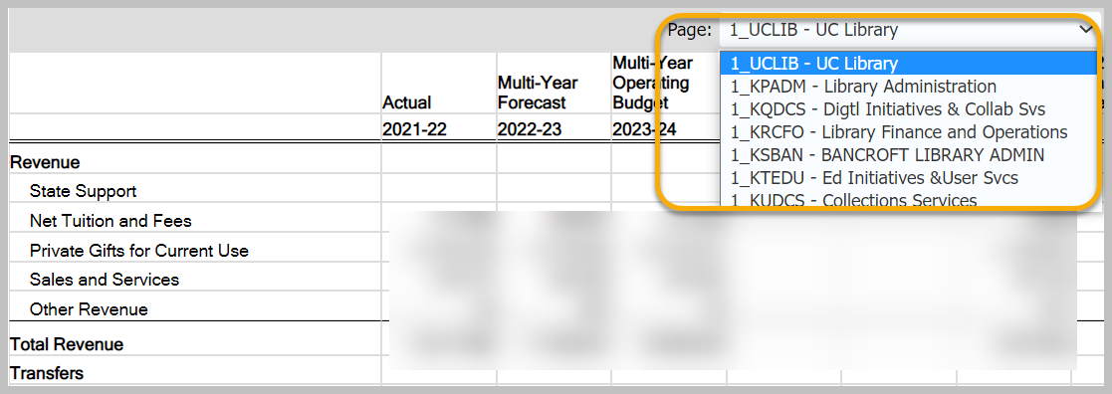
R180 Budget Template Report
Each entity is on a separate page. Use the Page drop-down to select the entity you want to display.
https://calplanning.berkeley.edu/multiyear-budget-template-job-aid

Slide 78
R181 Use of Reserves Template
The CalPlan R181 Use of Reserves presents the data from the Use of Reserves form

Slide 79
Online Resources
FY25 Budget Process
Release Notes
Training

Slide 80
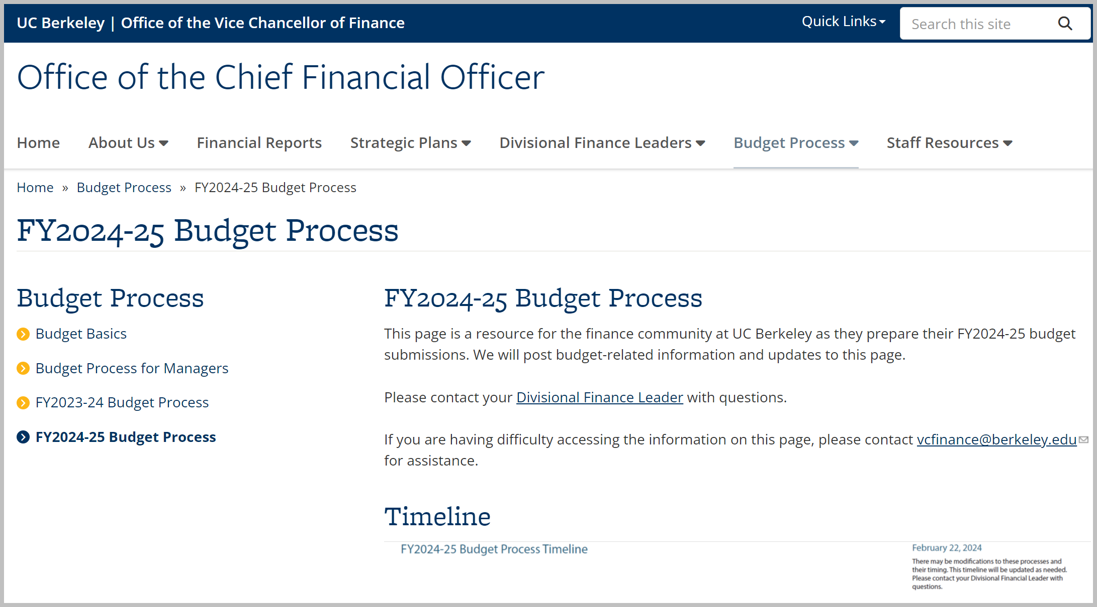
cfo.berkeley.edu
https://cfo.berkeley.edu/budget-process/fy2024-25-budget-process

Slide 81
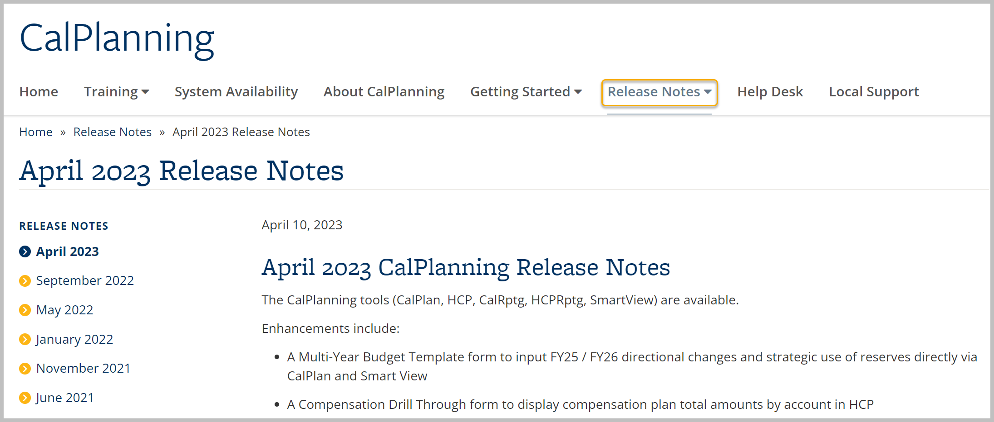
Release Notes
https://calplanning.berkeley.edu/release-notes

Slide 82
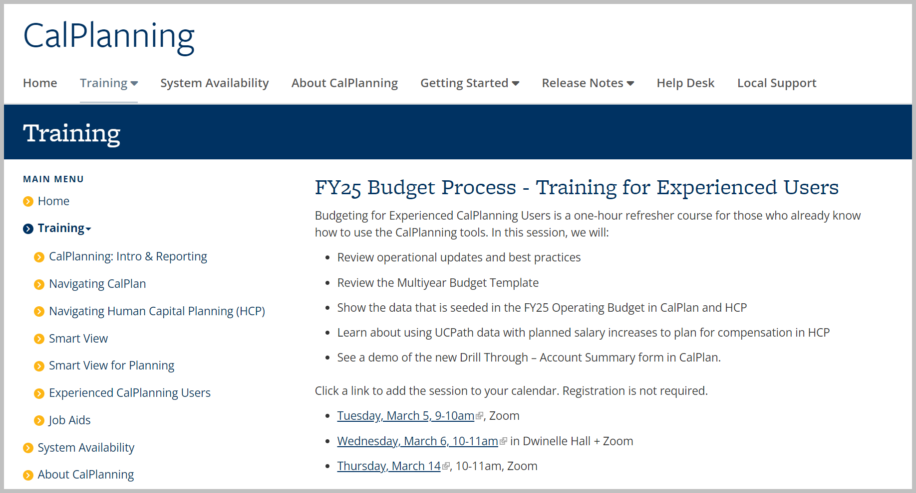
Training
https://calplanning.berkeley.edu/training

Slide 83
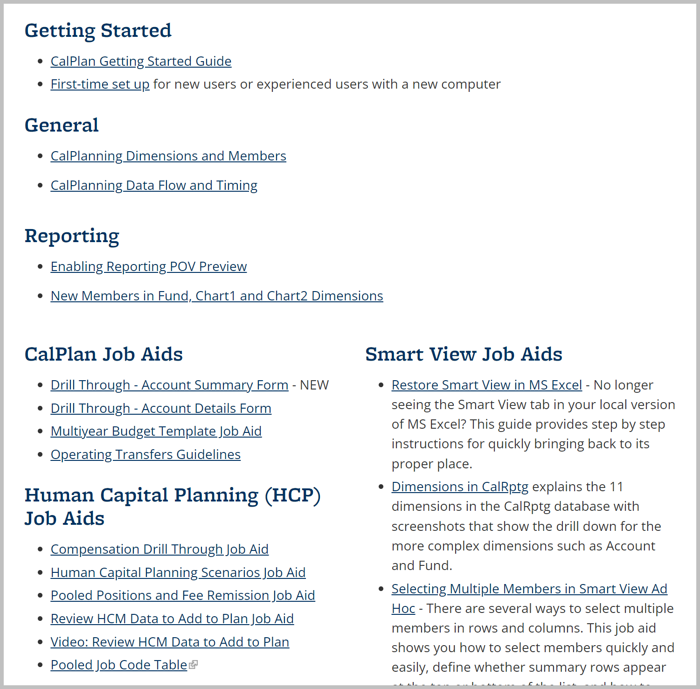
Job Aids
https://calplanning.berkeley.edu/training/job-aids

Slide 84
Thank you for your engagement.
Go Bears!

